Slide 1
LoL
by: Daniel Taylor | Johnny Hinton | Ramiz Midani | Wei Chi
Notes:
Presentation: 1. Some form of buildup to the 4 questions asked
2. Question -> Process > Result
3. Conclusion -> Q/A

Slide 2
Champion Usage Over Time
How is champion usage affected by:
Game type (ranked vs unranked);
Region (rich/English-speaking vs poor/non-English speaking); and
Patches

Slide 3
Champion Usage Over Time
Two factors
Game type
Ranked 5v5
Unranked 5v5
Region
Rich/English
EU Northeast
EU West
North America
Oceania
Poor/Non-English
Brazil
Latin America North
Latin America South
Russia
Turkey
Notes:
Which champions are mostly chosen across all games?
Does the champions usage seem to match up with some tier list of the time?
Are certain champions banned as a result?

Slide 4
Matchmaking Queue API
queue, queueId, gameQueueConfigId
But riftwalk.jsons has queue_type
Are they the same?

Slide 5
RIOT API
SR
SR x Banned Champs
ID | Description
0 | Custom
2 | 5v5 Blind
4 | 5v5 Ranked Solo
6 | 5v5 Ranked Premade
7 | Co-op vs AI (SR)
14 | 5v5 Draft Pick
42 | 5v5 Ranked Team
ID | Frequency
0 | 234
1 | 10253
5 | 9
7 | 18337
9 | 1677
14 | 7106 – unranked?
ID | Frequency
0 | 72
1 | 2291
- | -
7 | 18337 – ranked?
9 | 1677
- | -

Slide 6
Data Issues
 | Ranked | Unranked
Rich/English | 2014-07-30 to 2014-09-10 # of Champions – 5,281,580 0000--12-31 | 2014-07-30 to 09-10 # of Champions – 2,392,880 0000--12-31
Poor/Non-English | 2014-07-28 to 2014-09-24 # of Champions – 324,980 0000--12-31 Missing: 07-29, 09-10, 09-13, 09-15, 09-17 to 09-21, 09-23 Very, very few games: 07-28 2014-07-30 to 2014-09-09 | 2014-07-30 to 09-08 # of Champions – 93,180

Slide 7
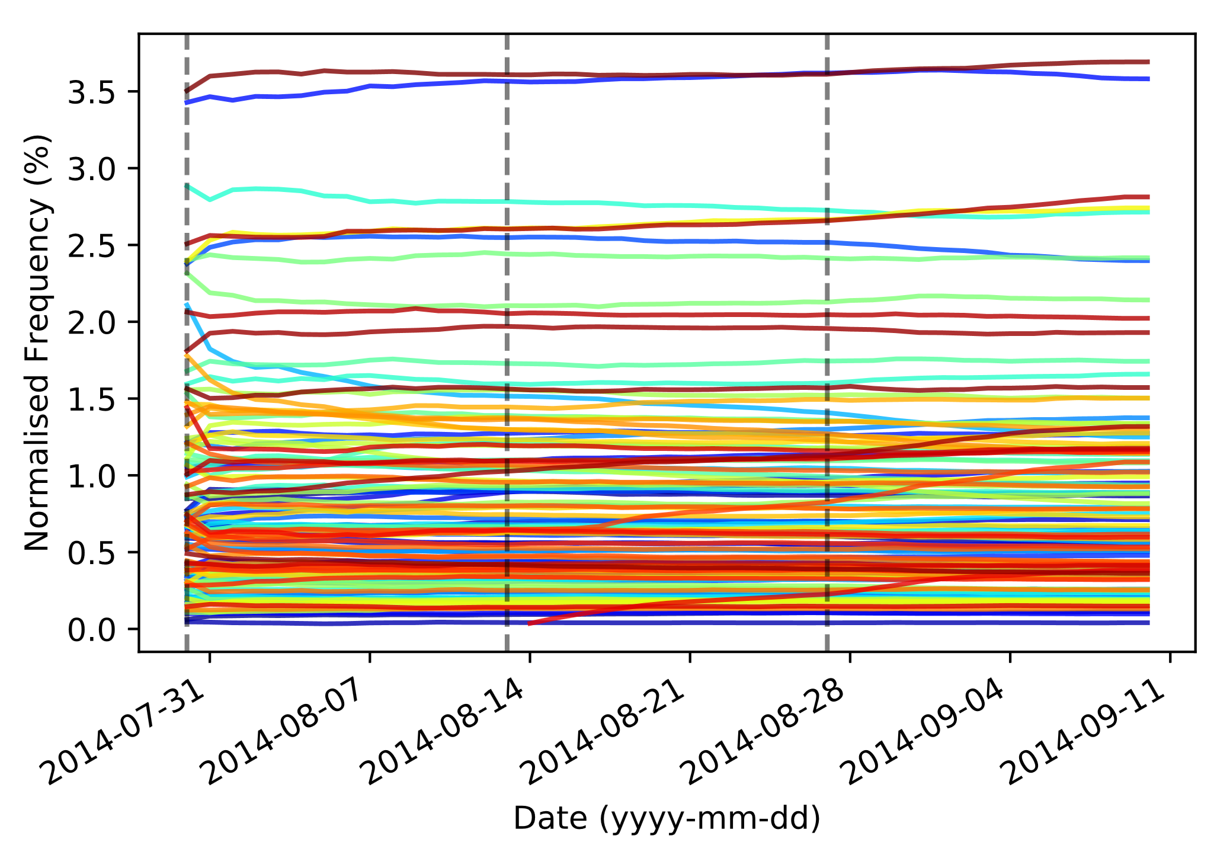
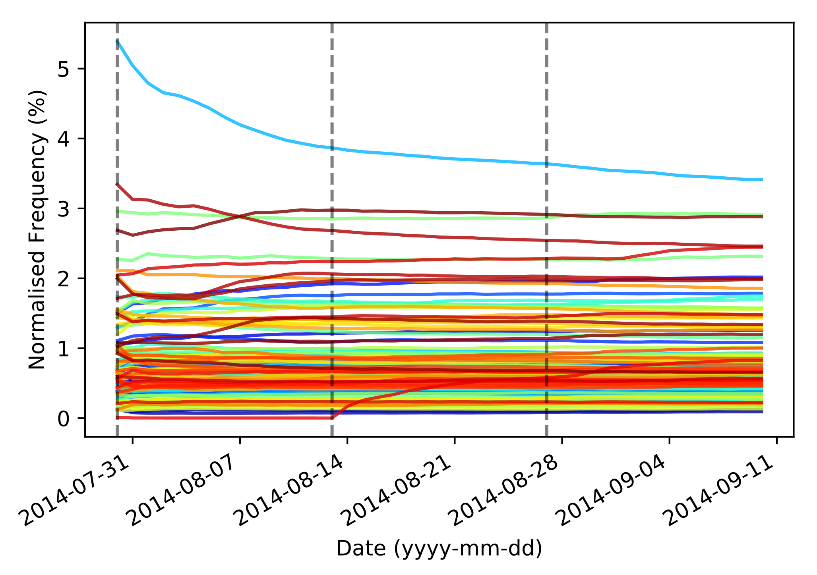
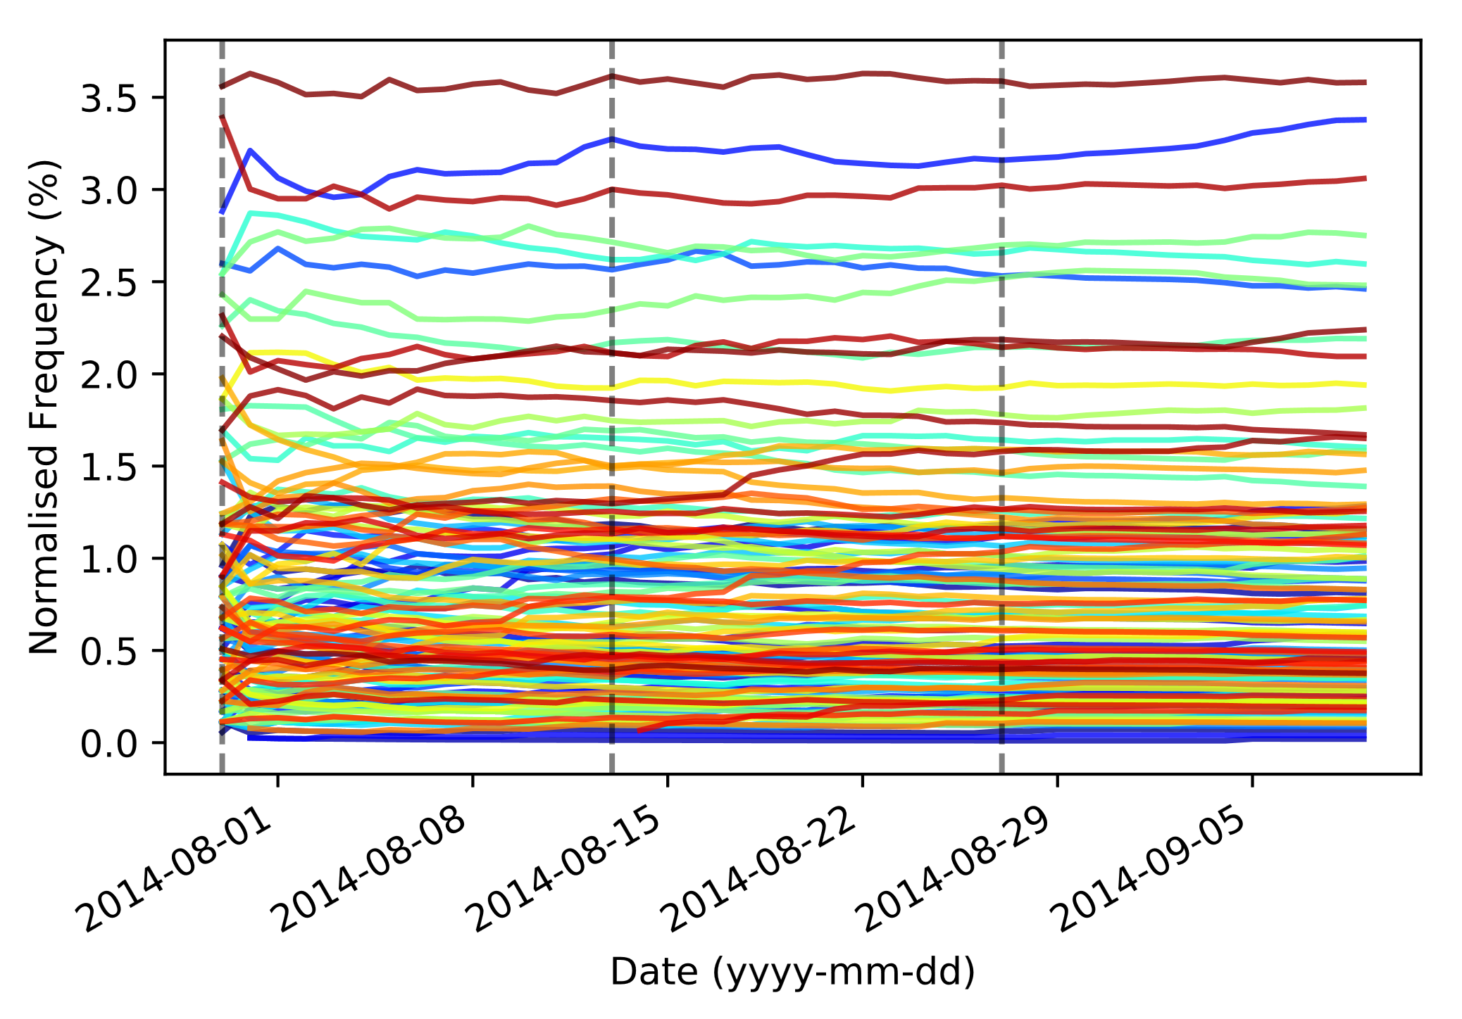
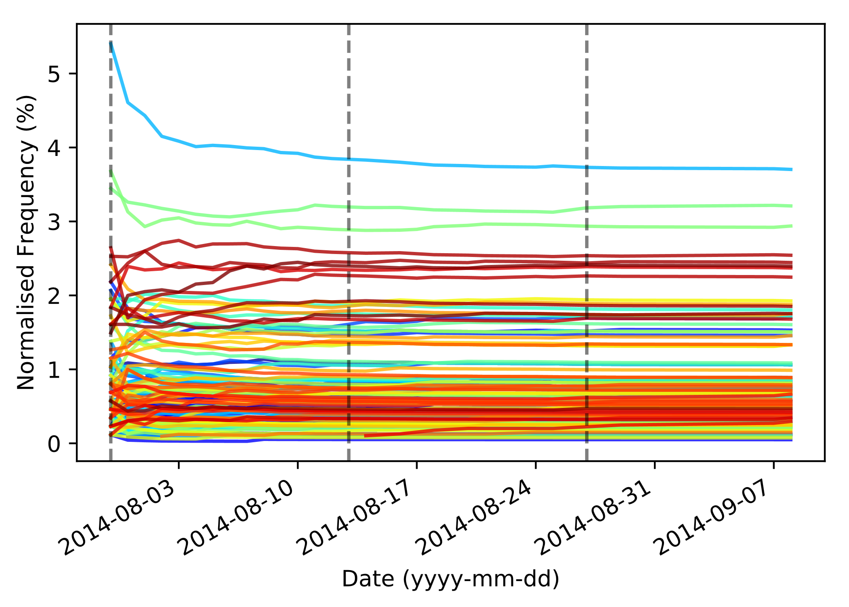
Ranked
Unranked
Rich/English
Poor/Non-English

Slide 8
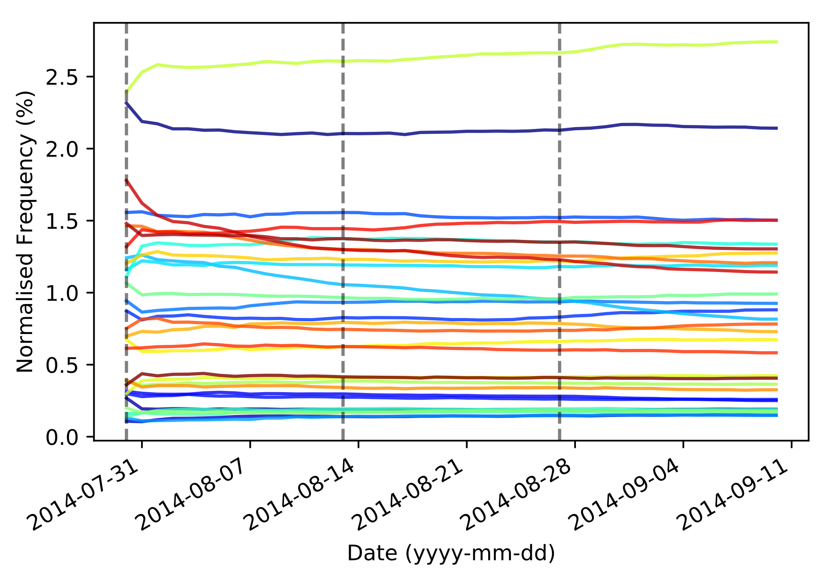
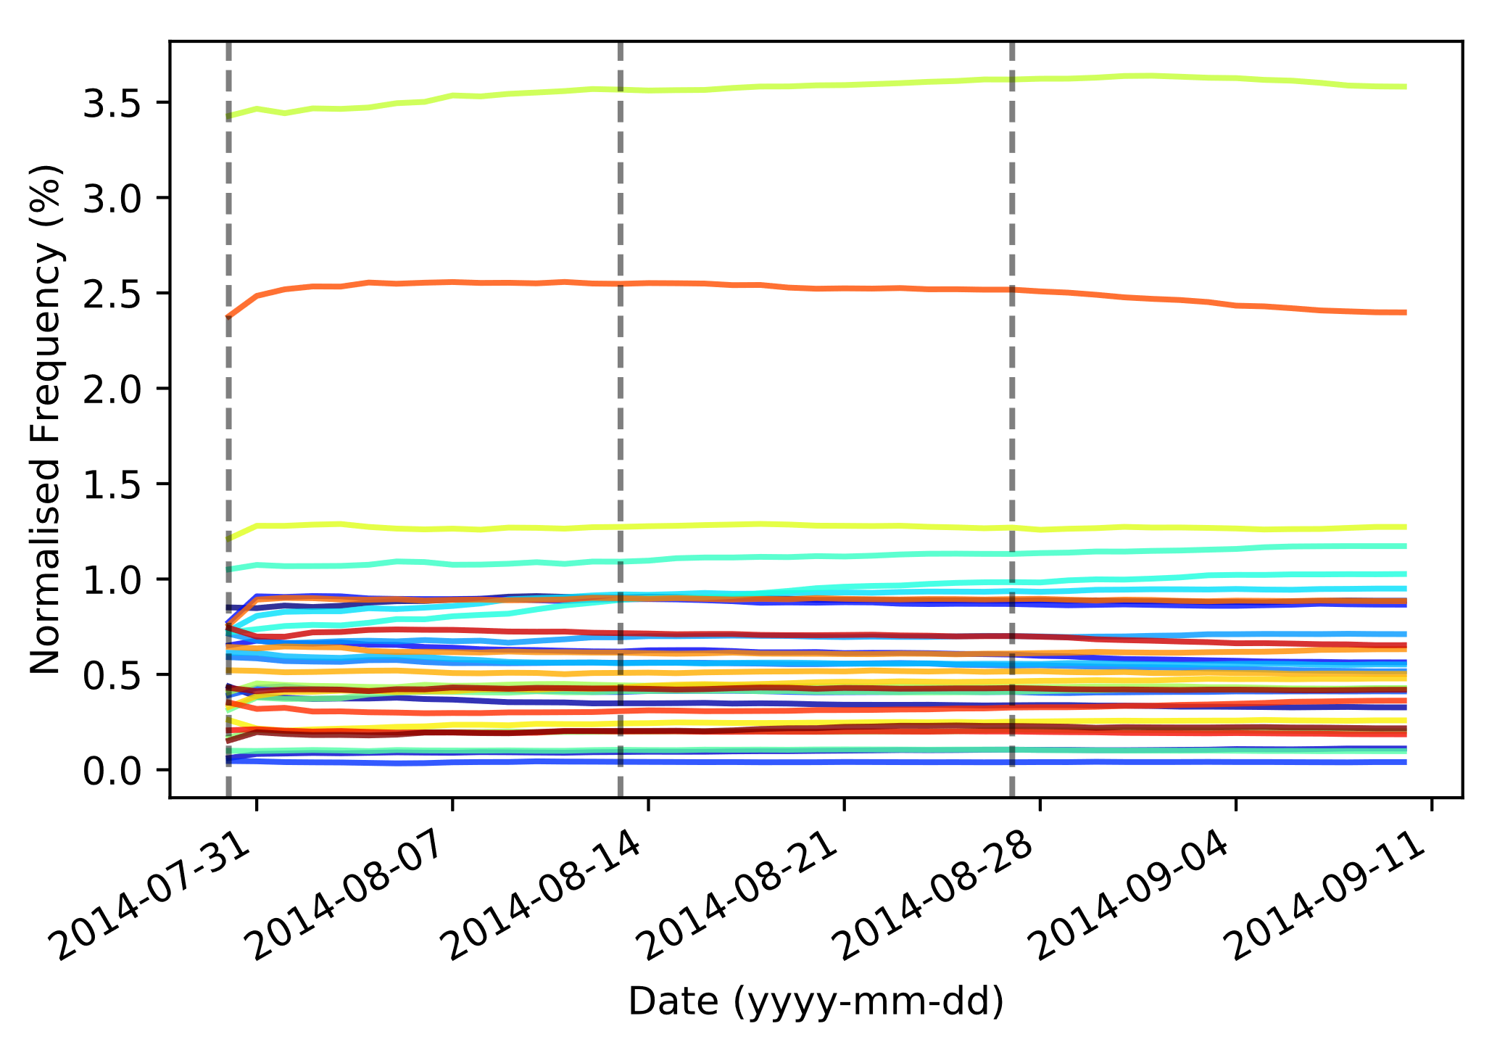
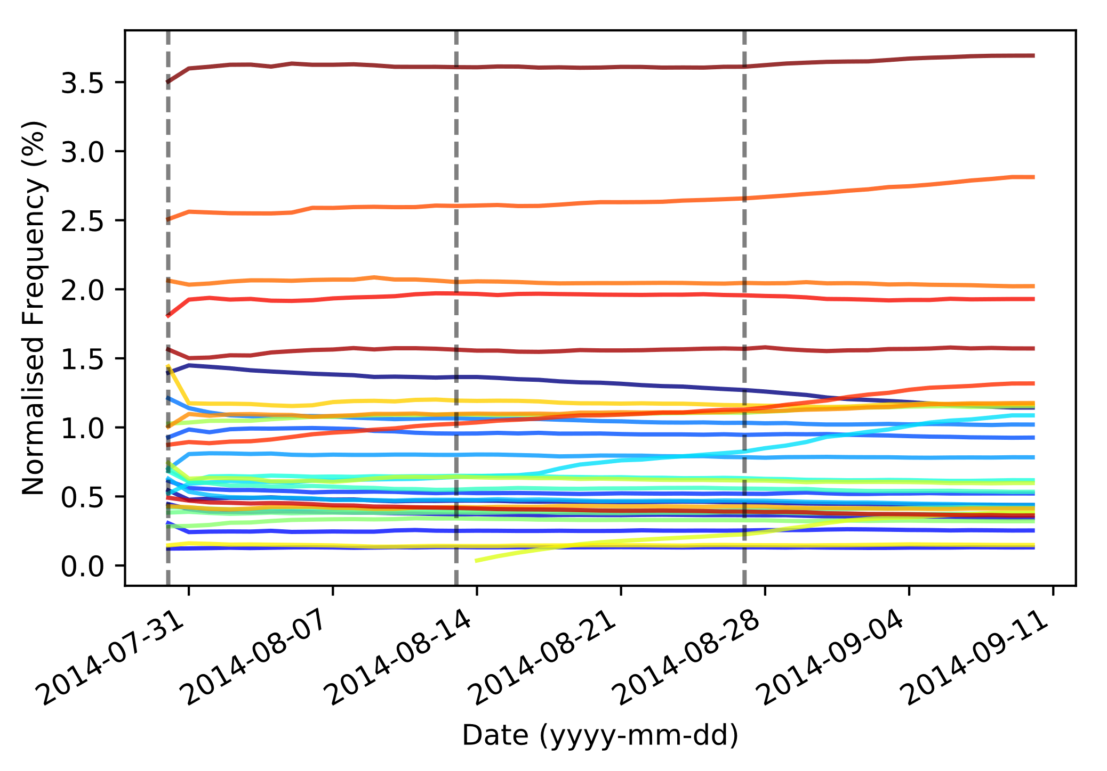
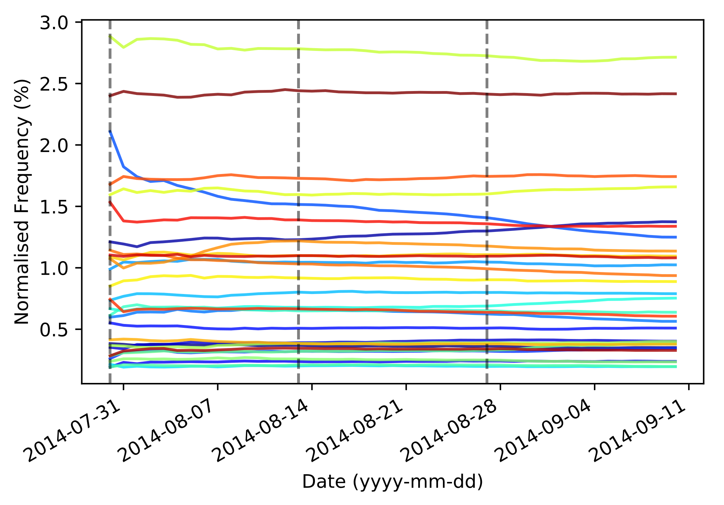
Ranked x Rich/English

Slide 9
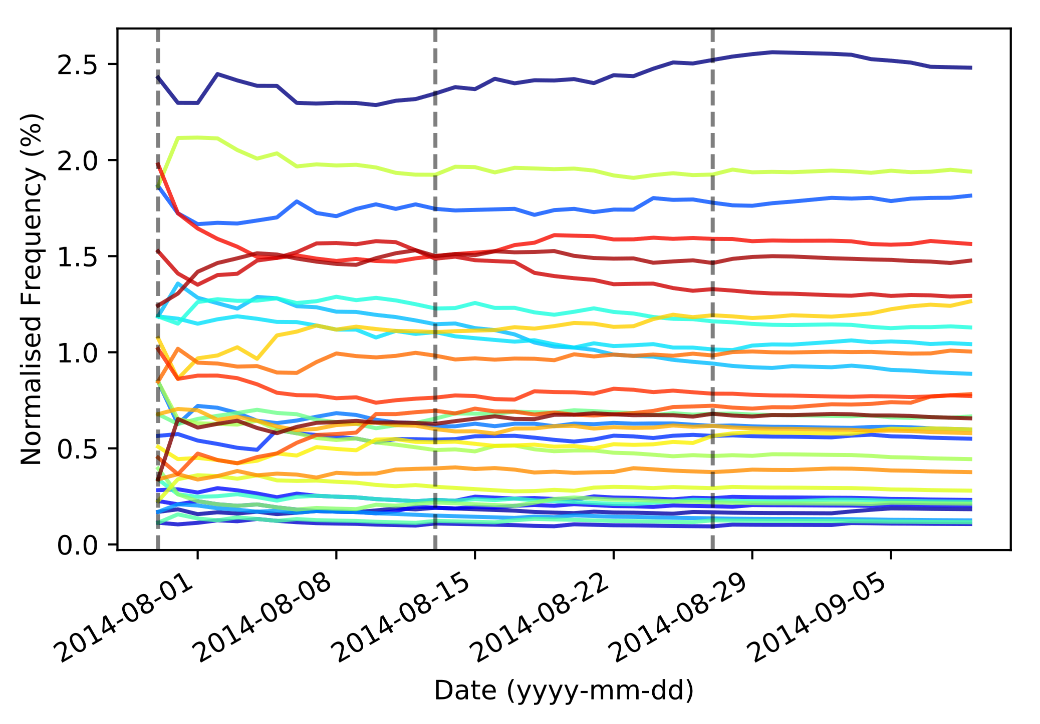
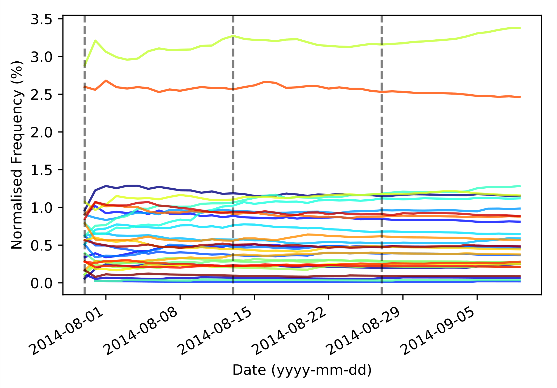
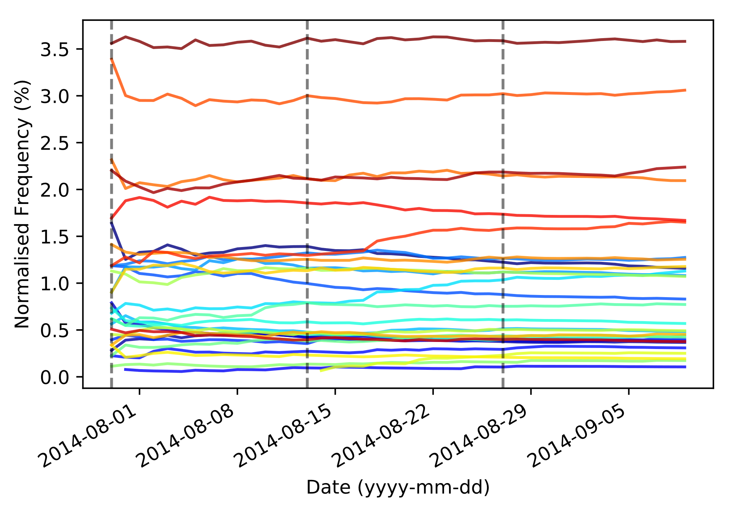
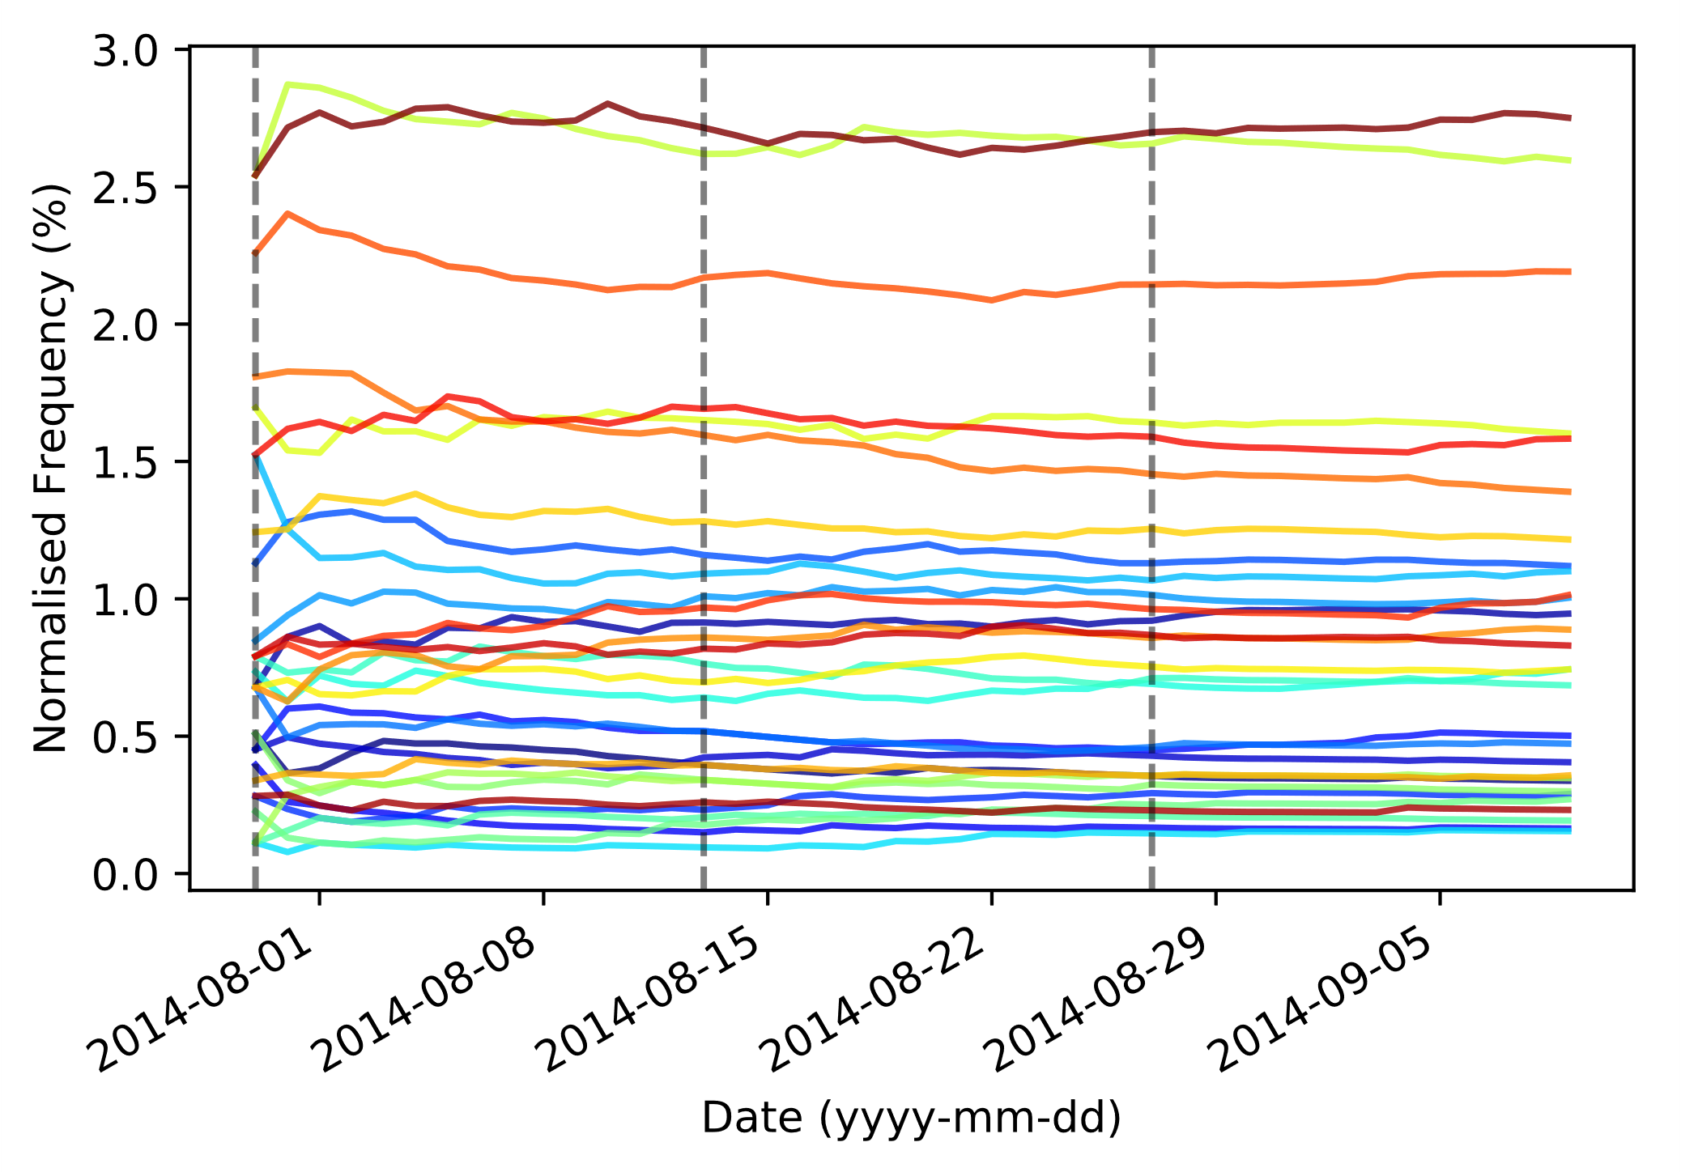
Ranked x Poor/Non-English

Slide 10
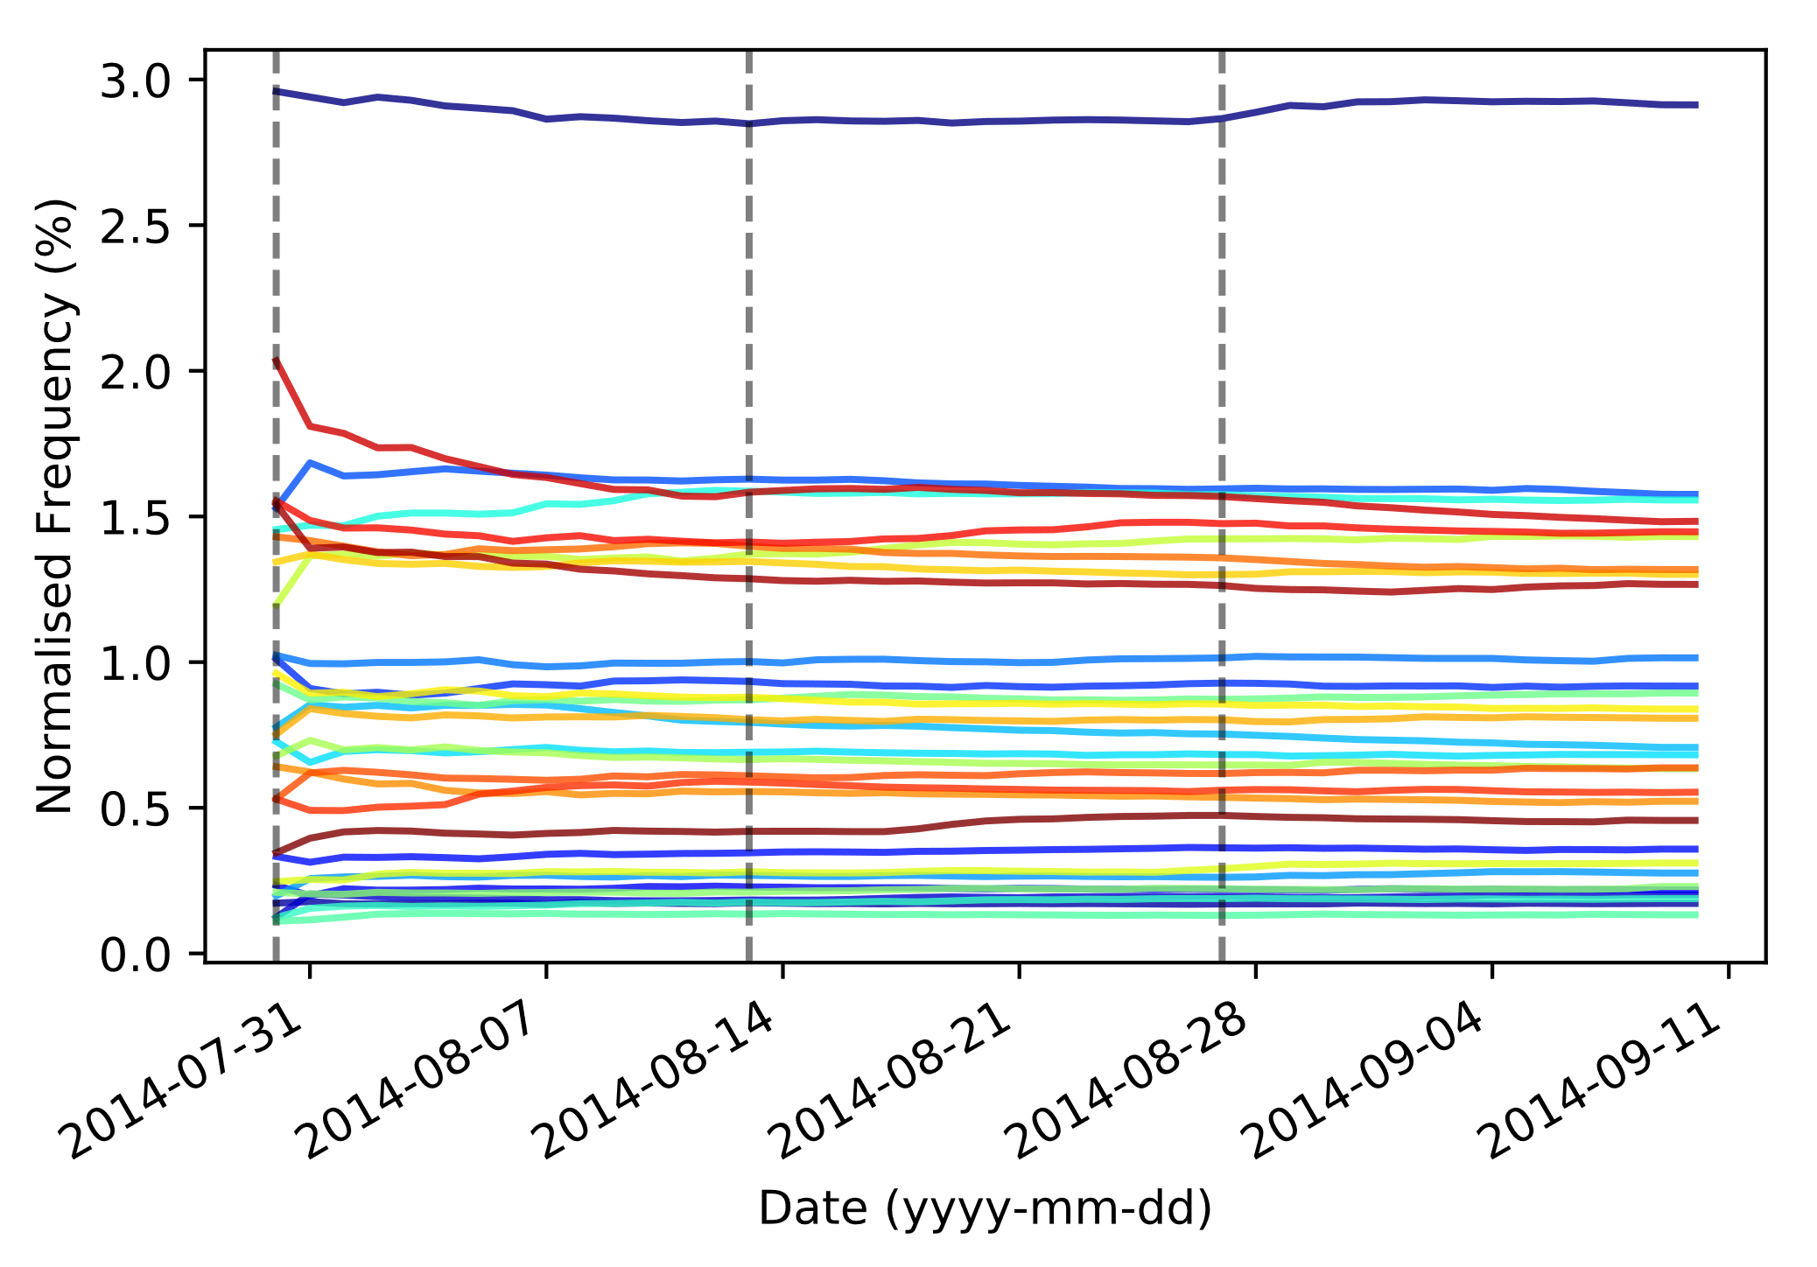
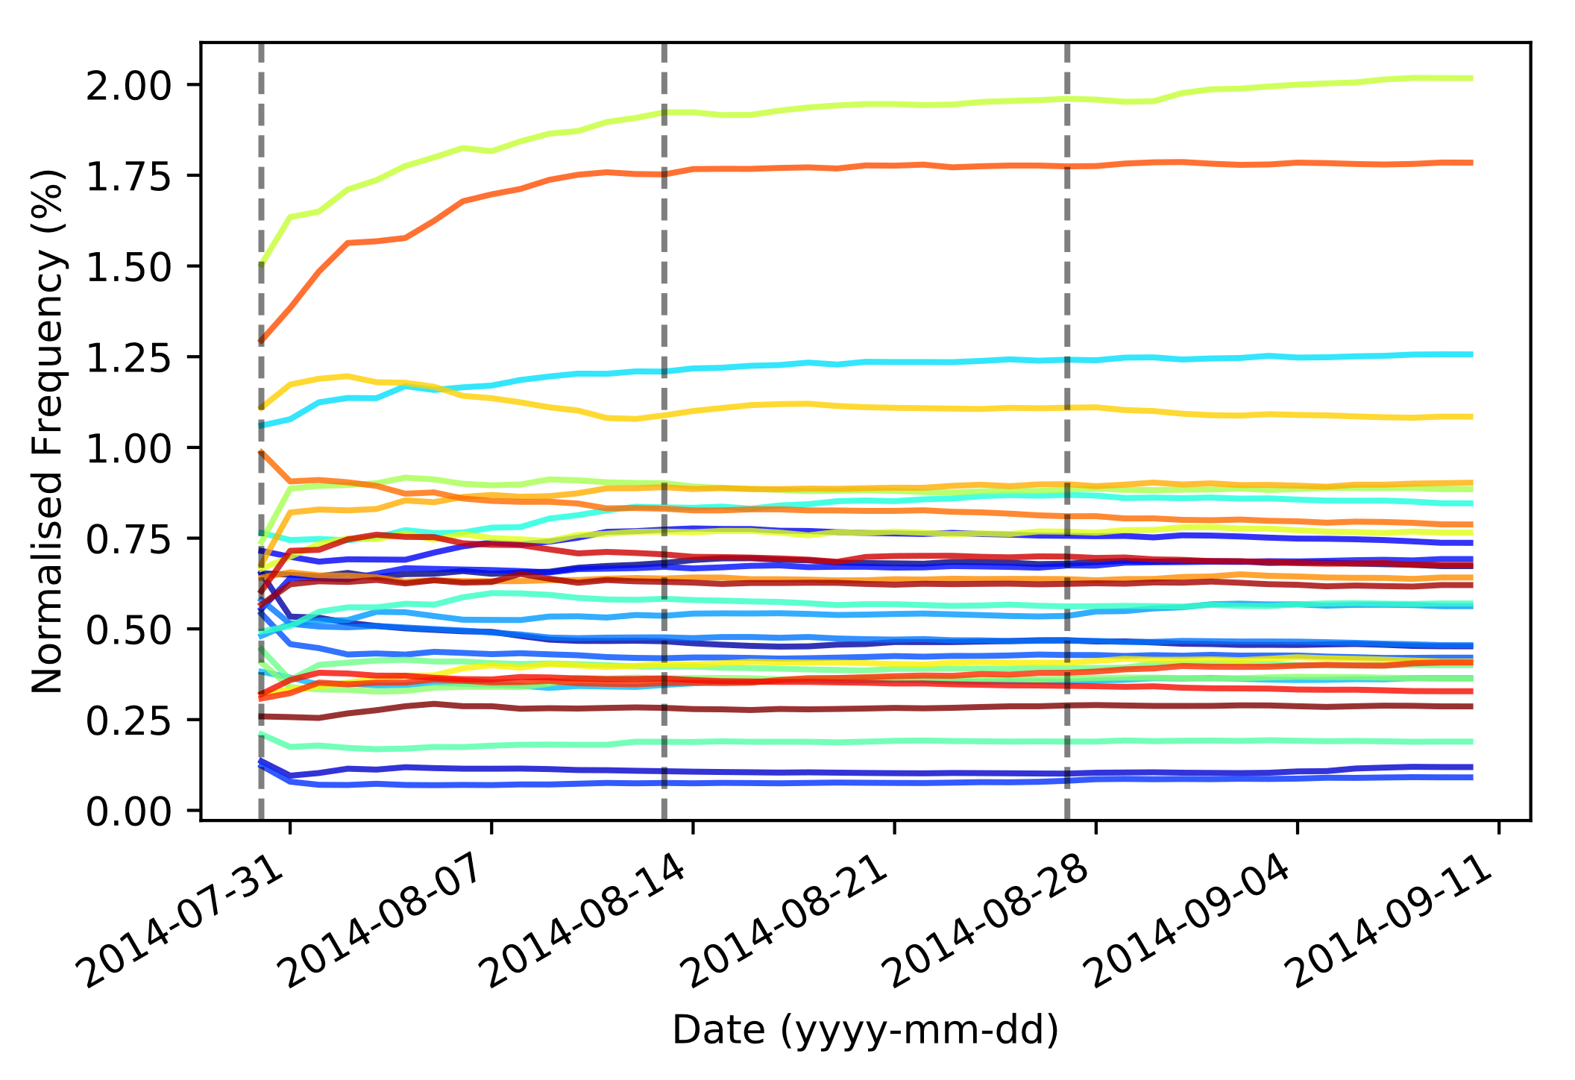
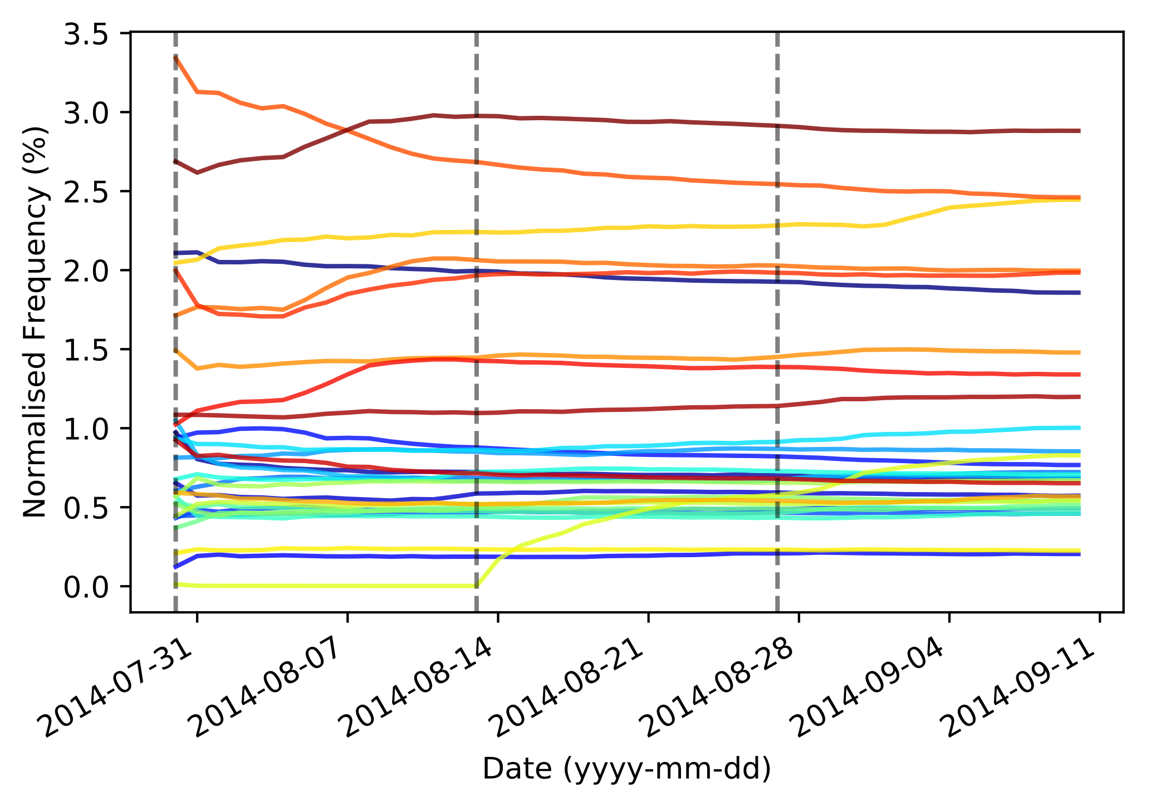
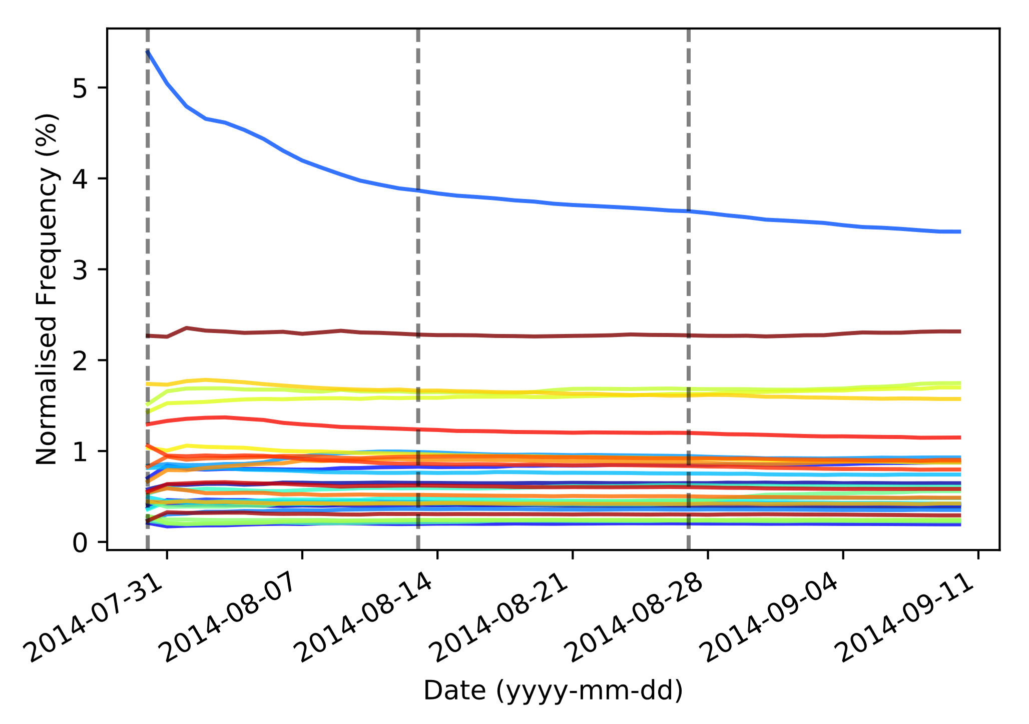
Unranked x Rich/English

Slide 11
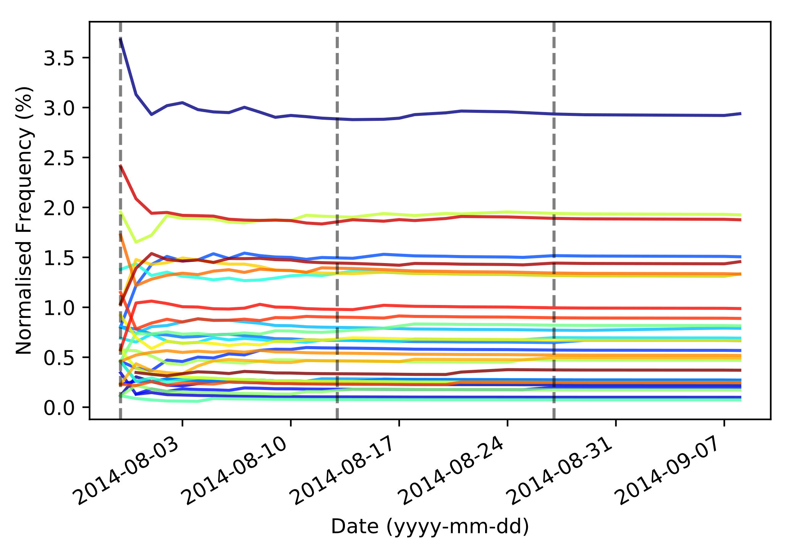
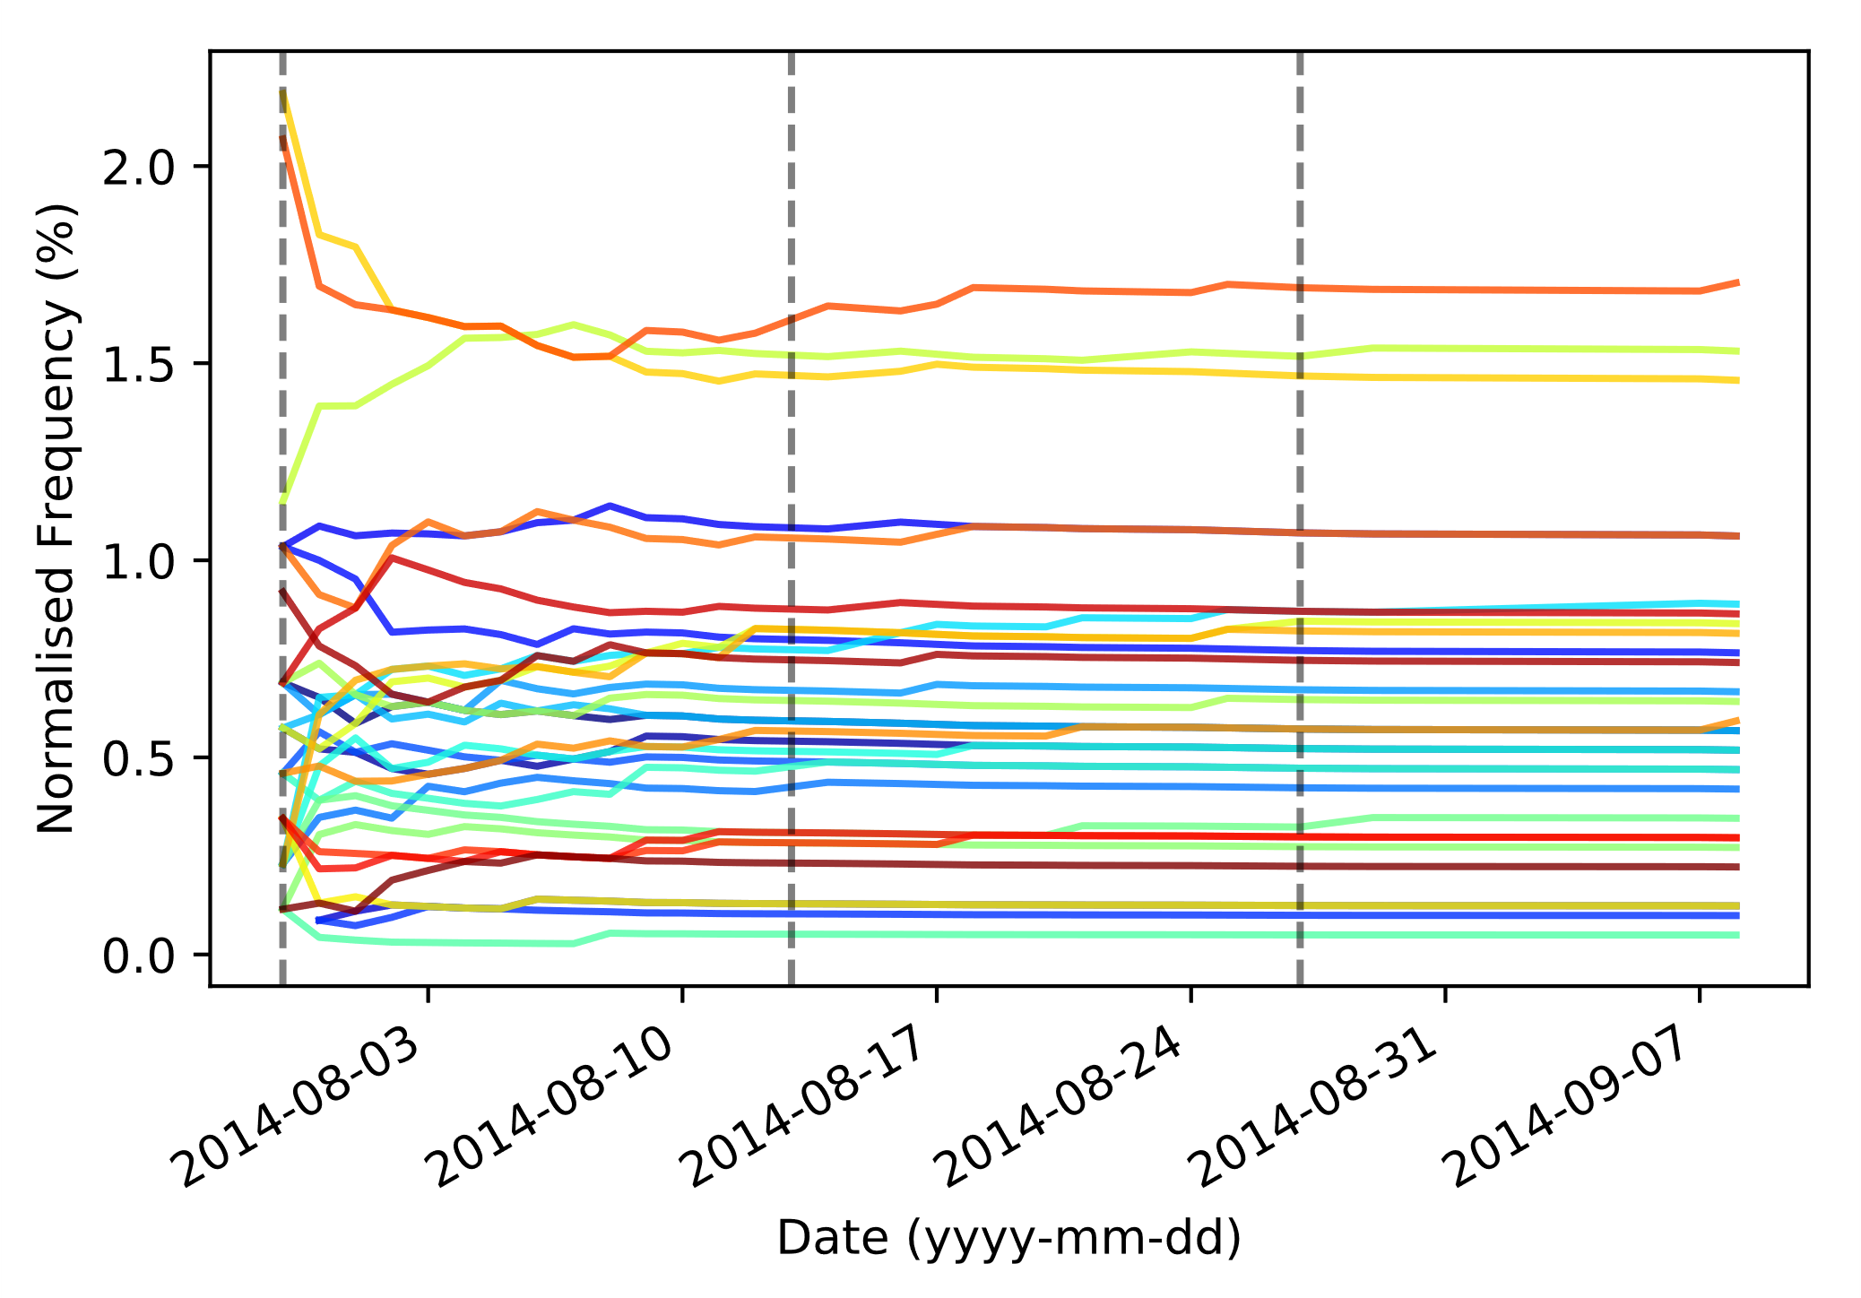
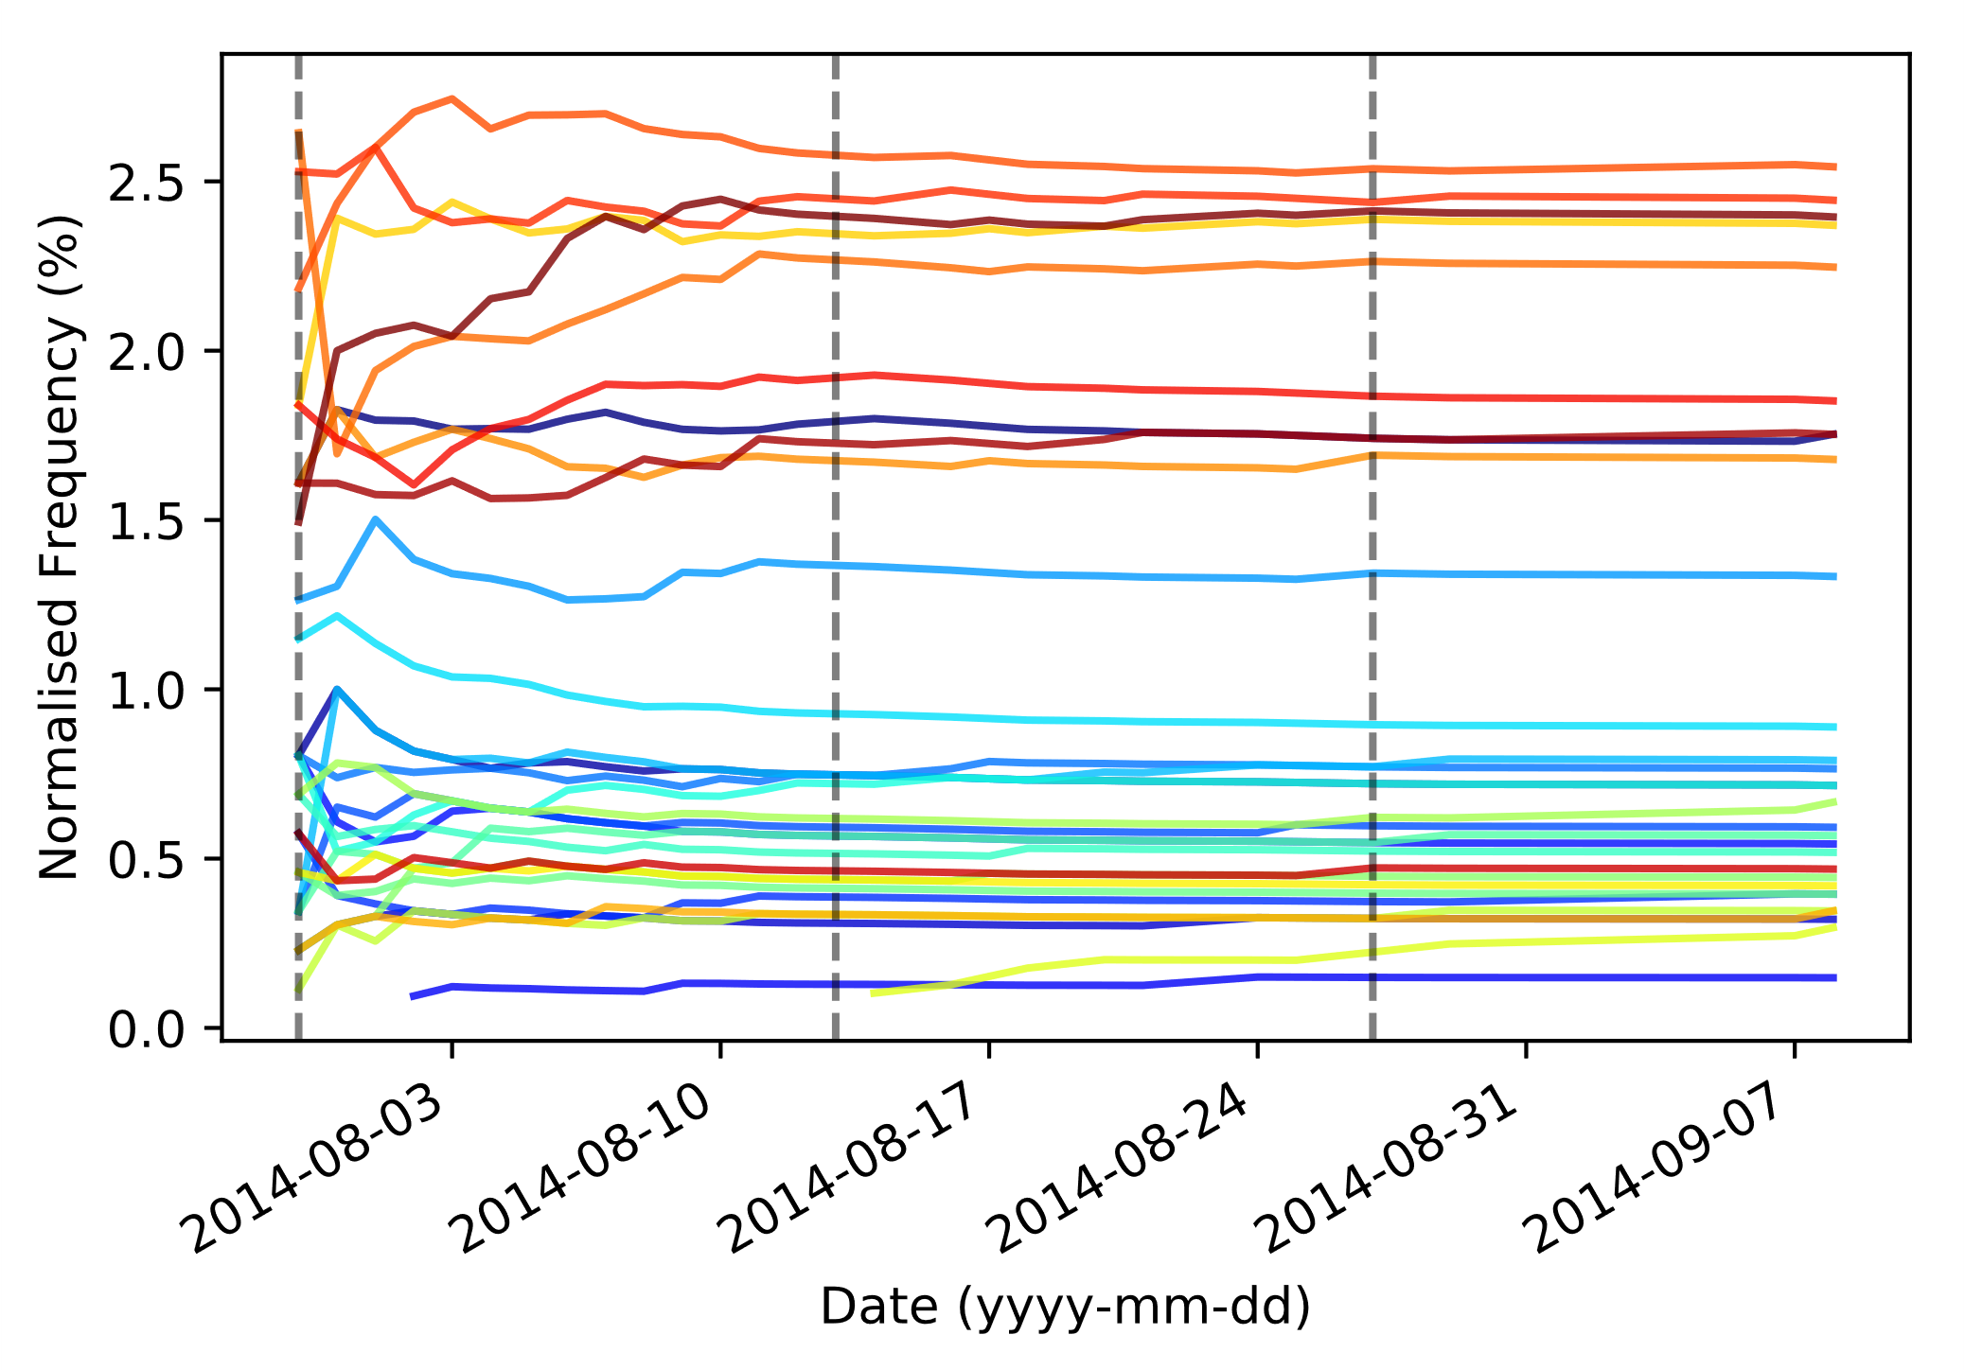
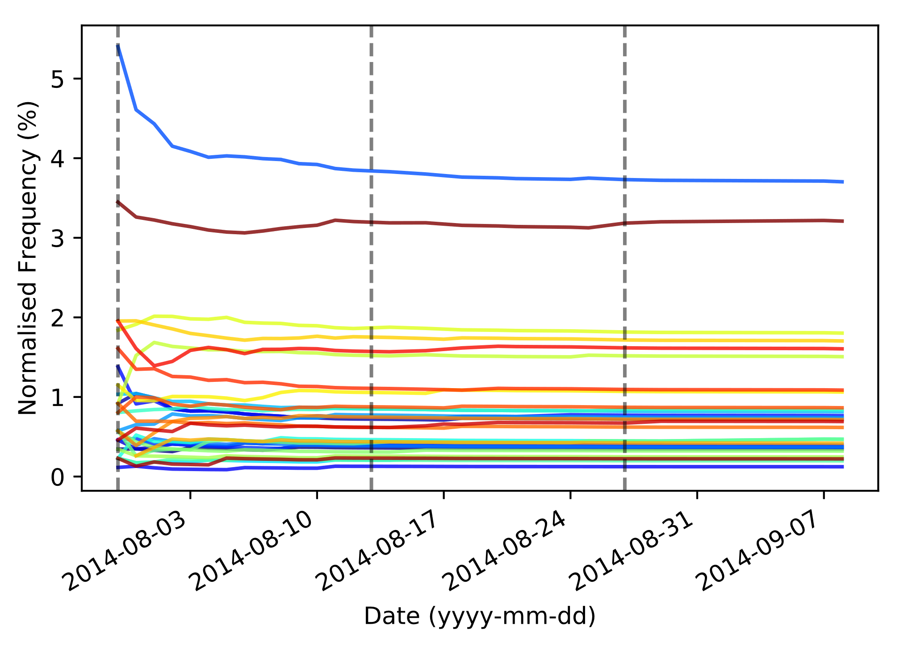
Unranked x Poor/Non-English

Slide 12
Game Durations
How is game duration affected by:
Game type (ranked vs unranked); and
Region (rich/English-speaking vs poor/non-English speaking)?

Slide 13
Game Durations
Two factors
Game type
Ranked 5v5
Unranked 5v5
Region
Rich/English
EU Northeast
EU West
North America
Oceania
Poor/Non-English
Brazil
Latin America North
Latin America South
Russia
Turkey
Notes:
Comparison of NA and SA ranked/unranked matches in terms of duration.
Which culture is more willing to let a match go on before surrender/defeat
How long do games typically last before a conclusion is made within a ranked/unranked match

Slide 14
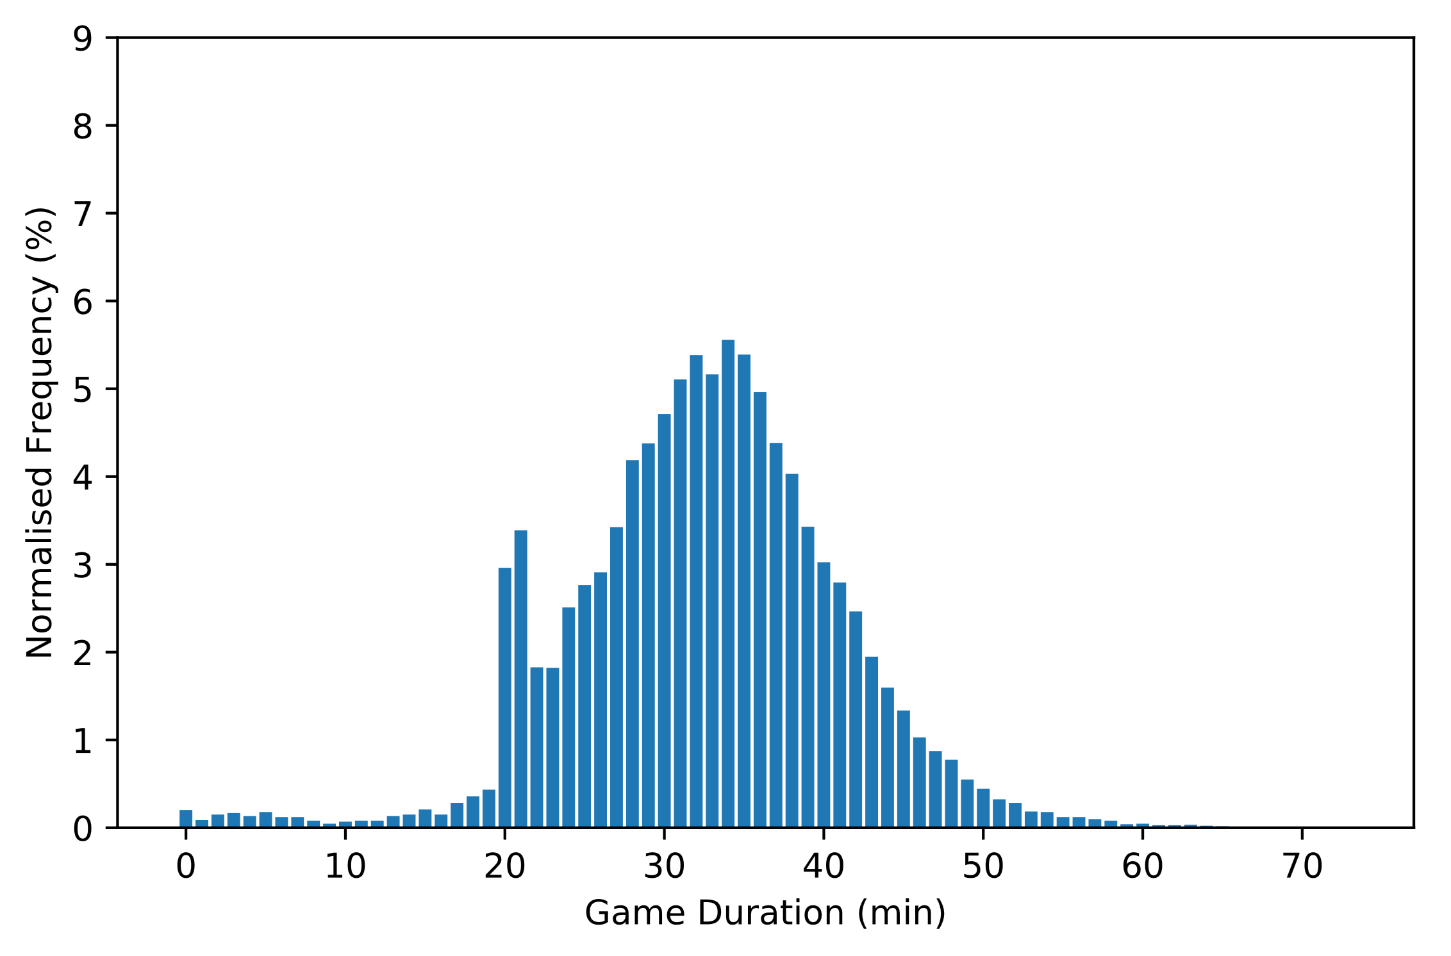
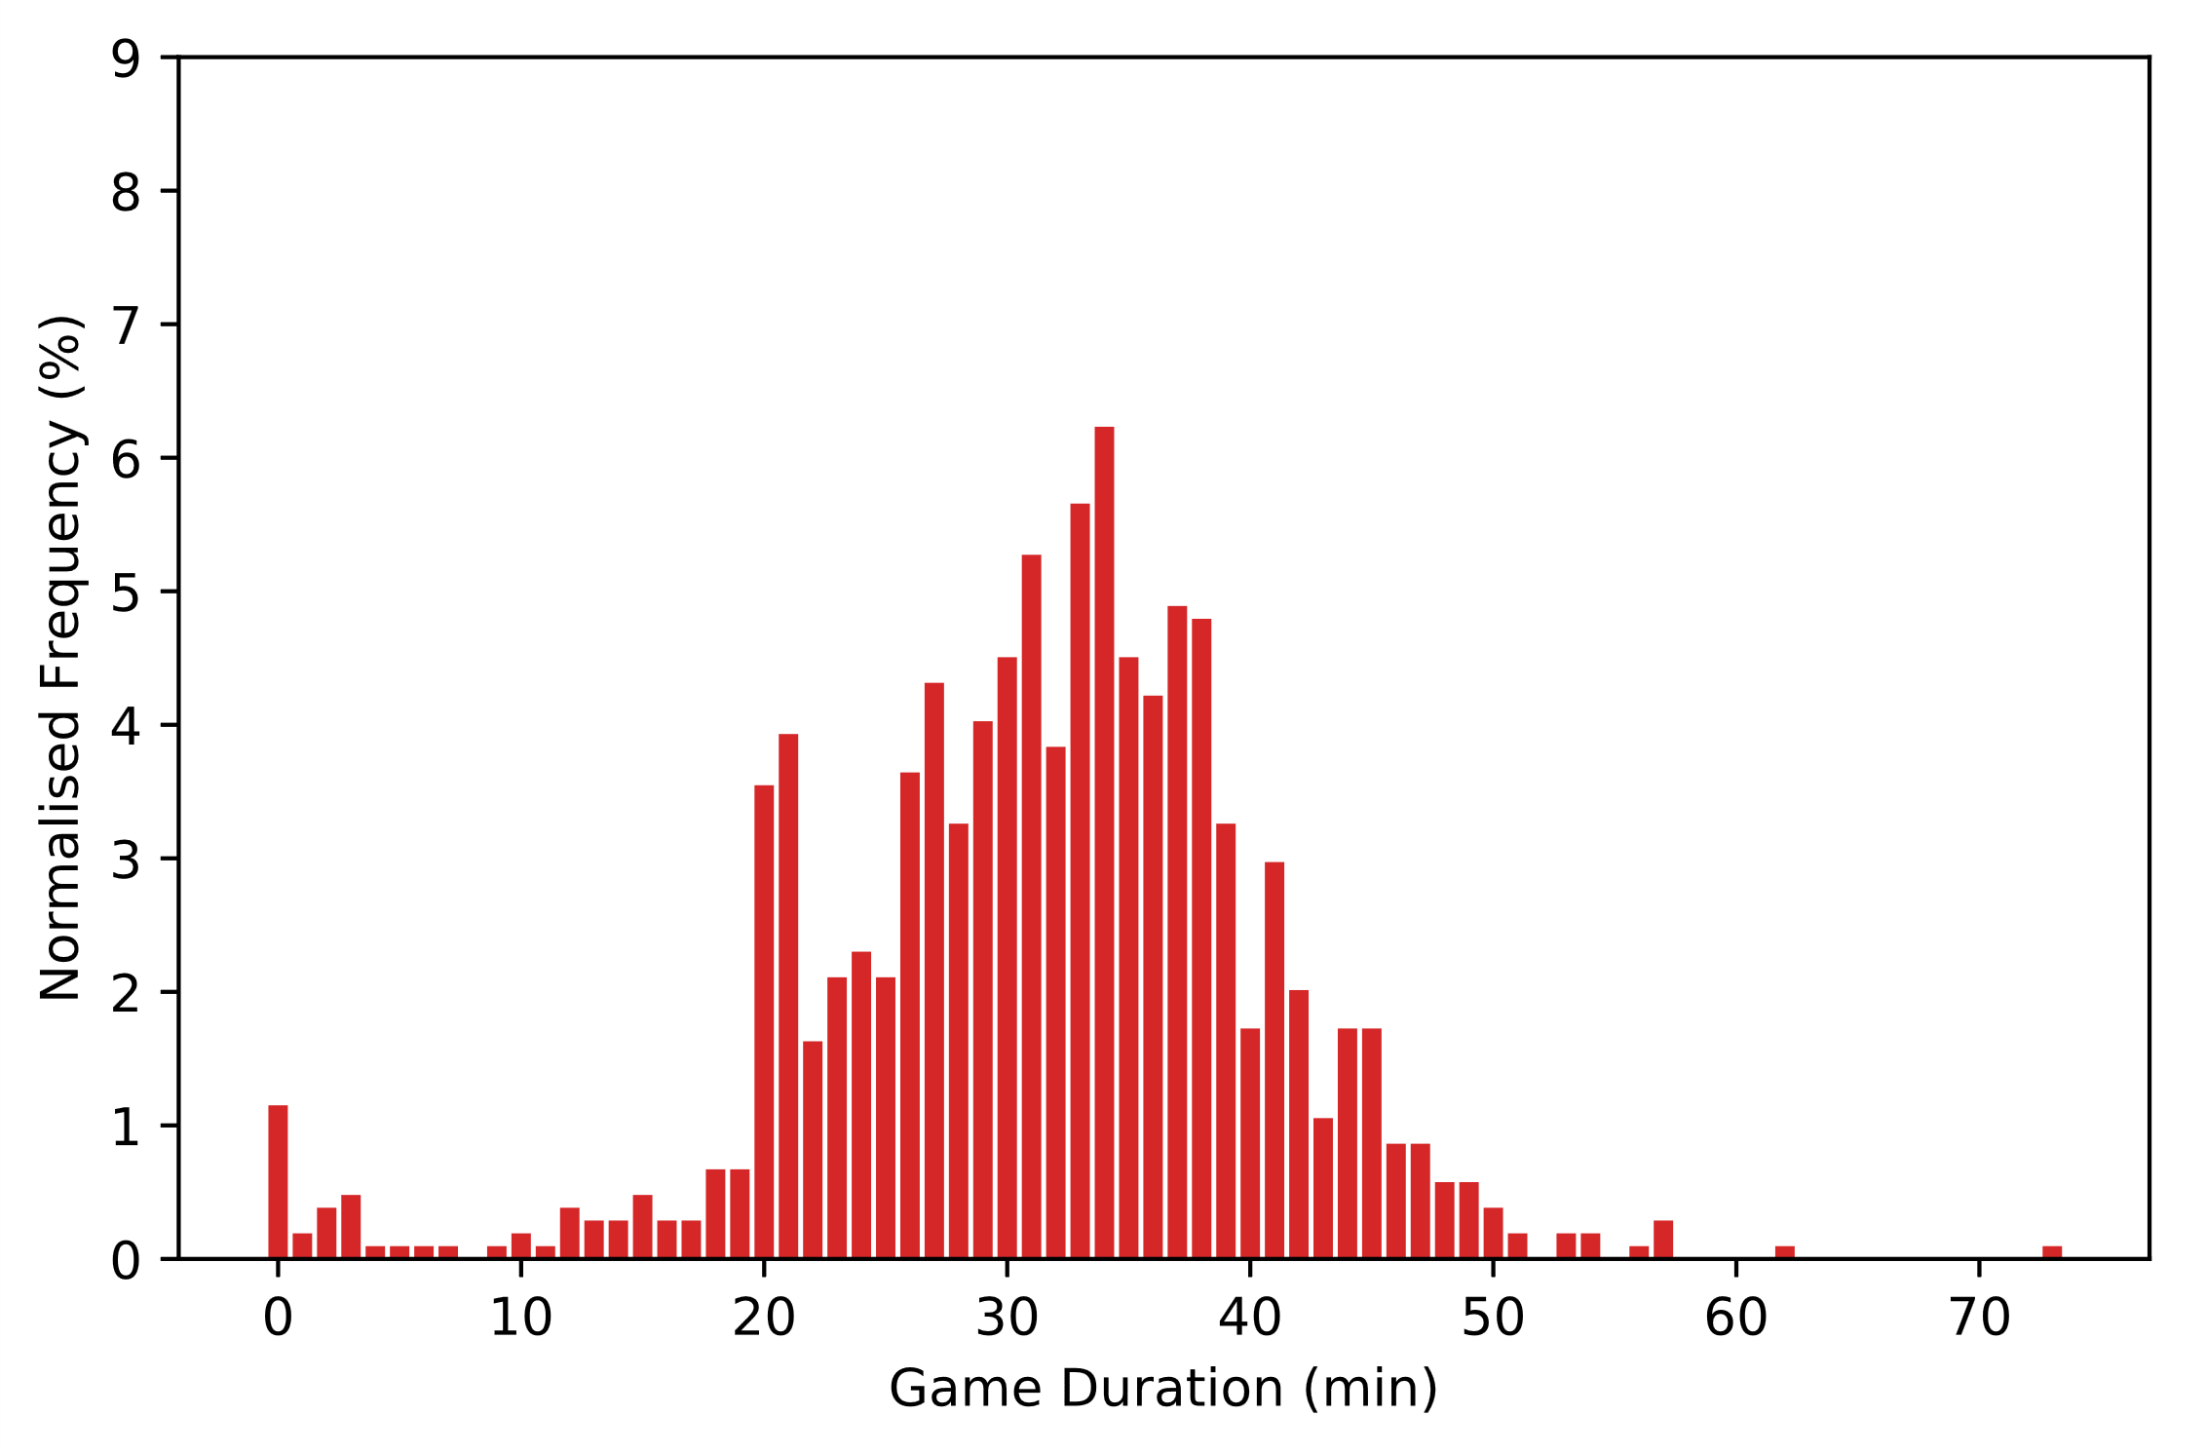
Ranked x Rich/English
N | max | med | mean | s
17,294 | 77 | 33 | 32.5614 | 8.3729
Ranked x Poor/Non-English
N | max | med | mean | s
1,043 | 73 | 32 | 31.4171 | 9.3157

Slide 15
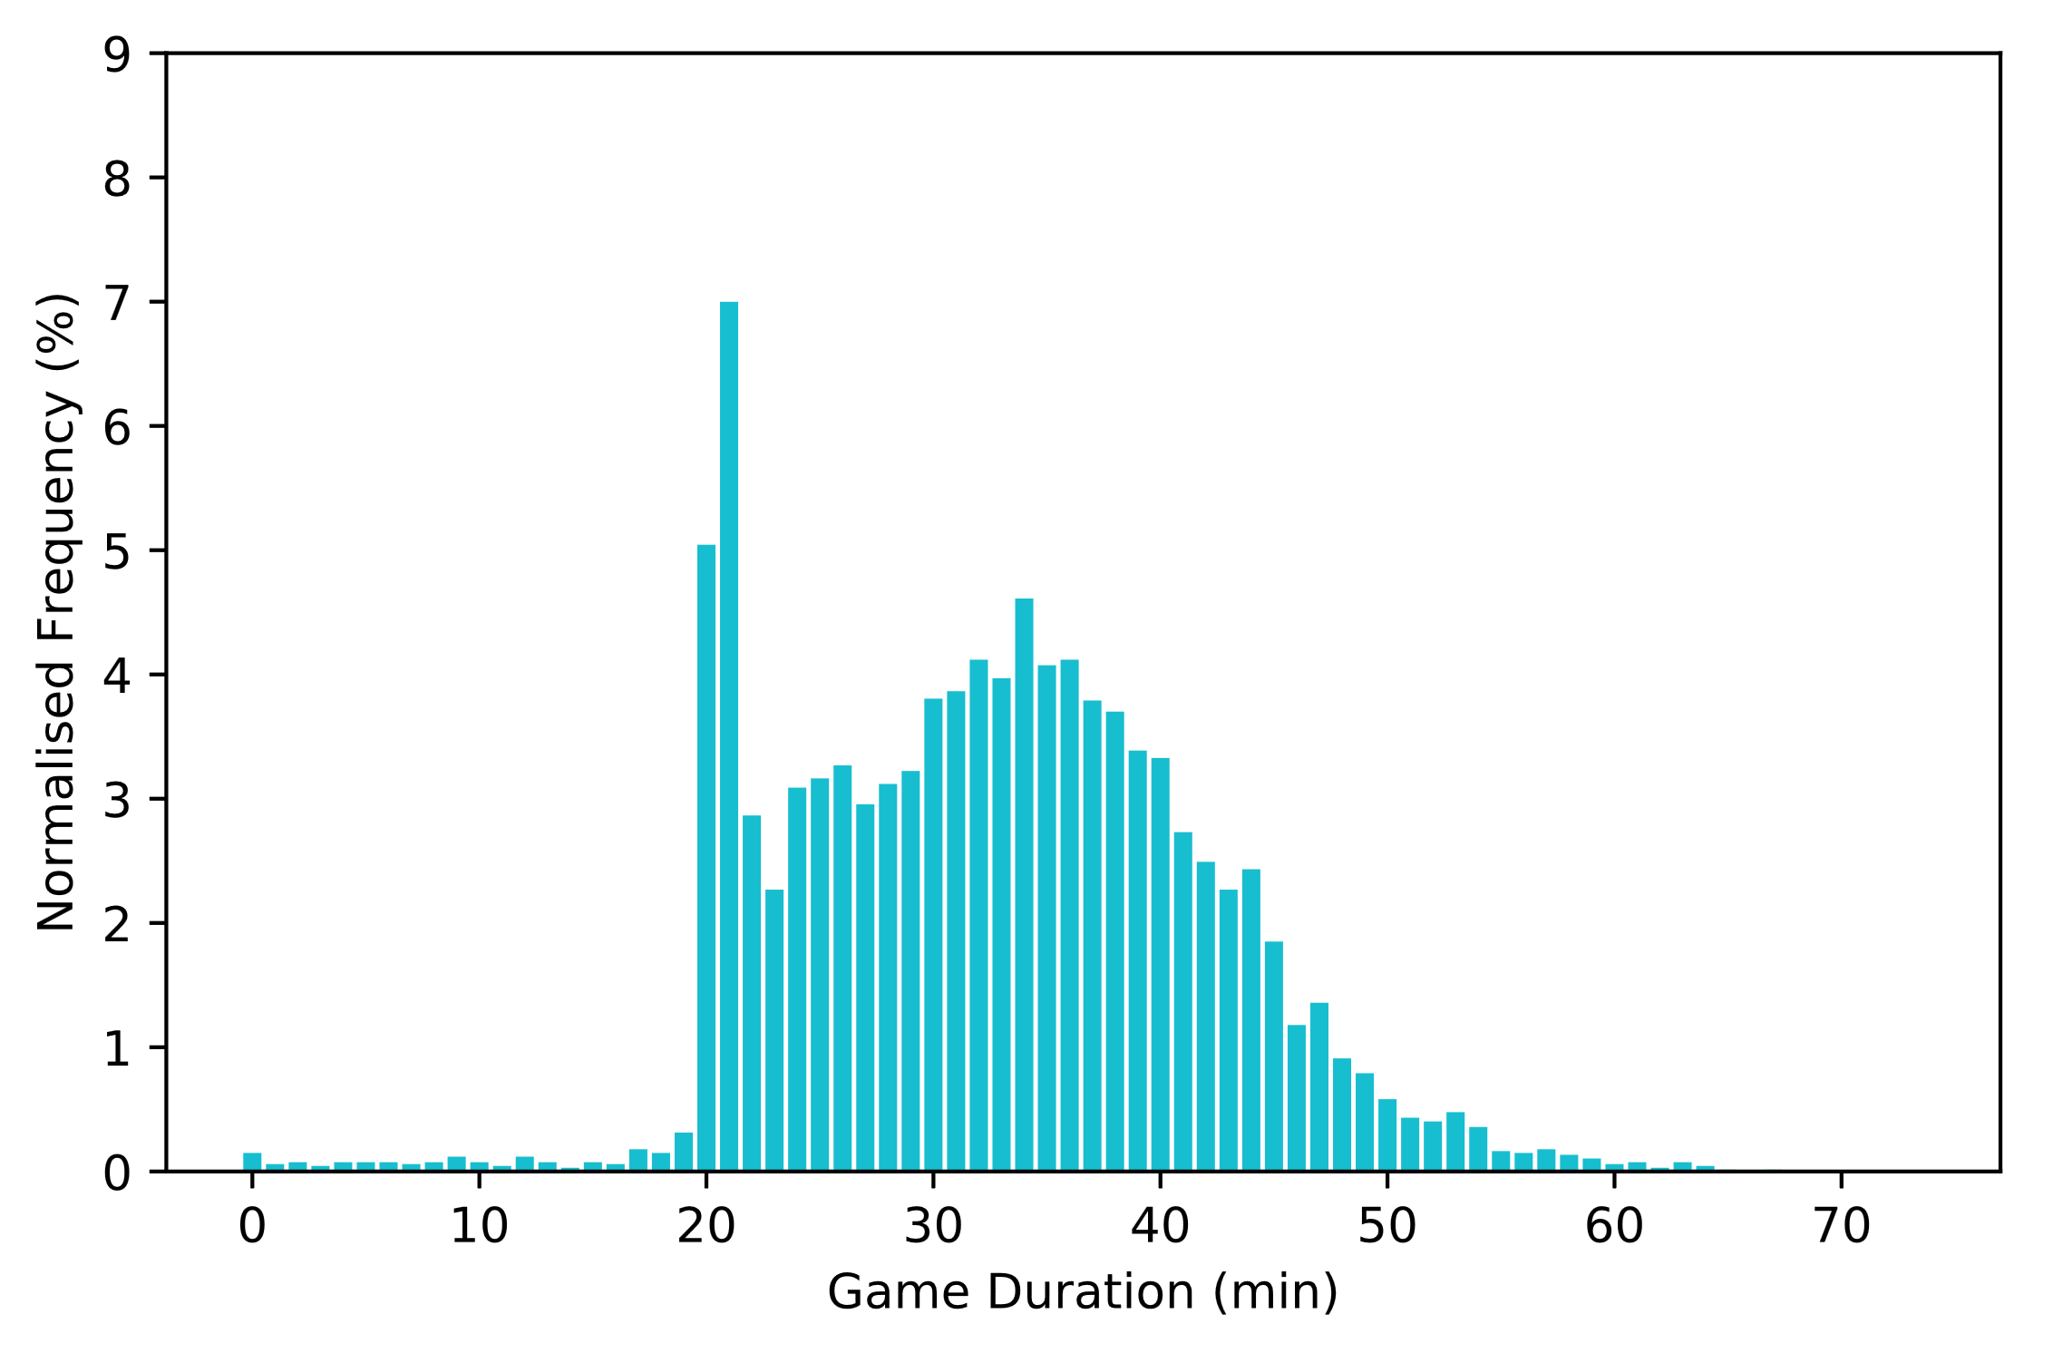
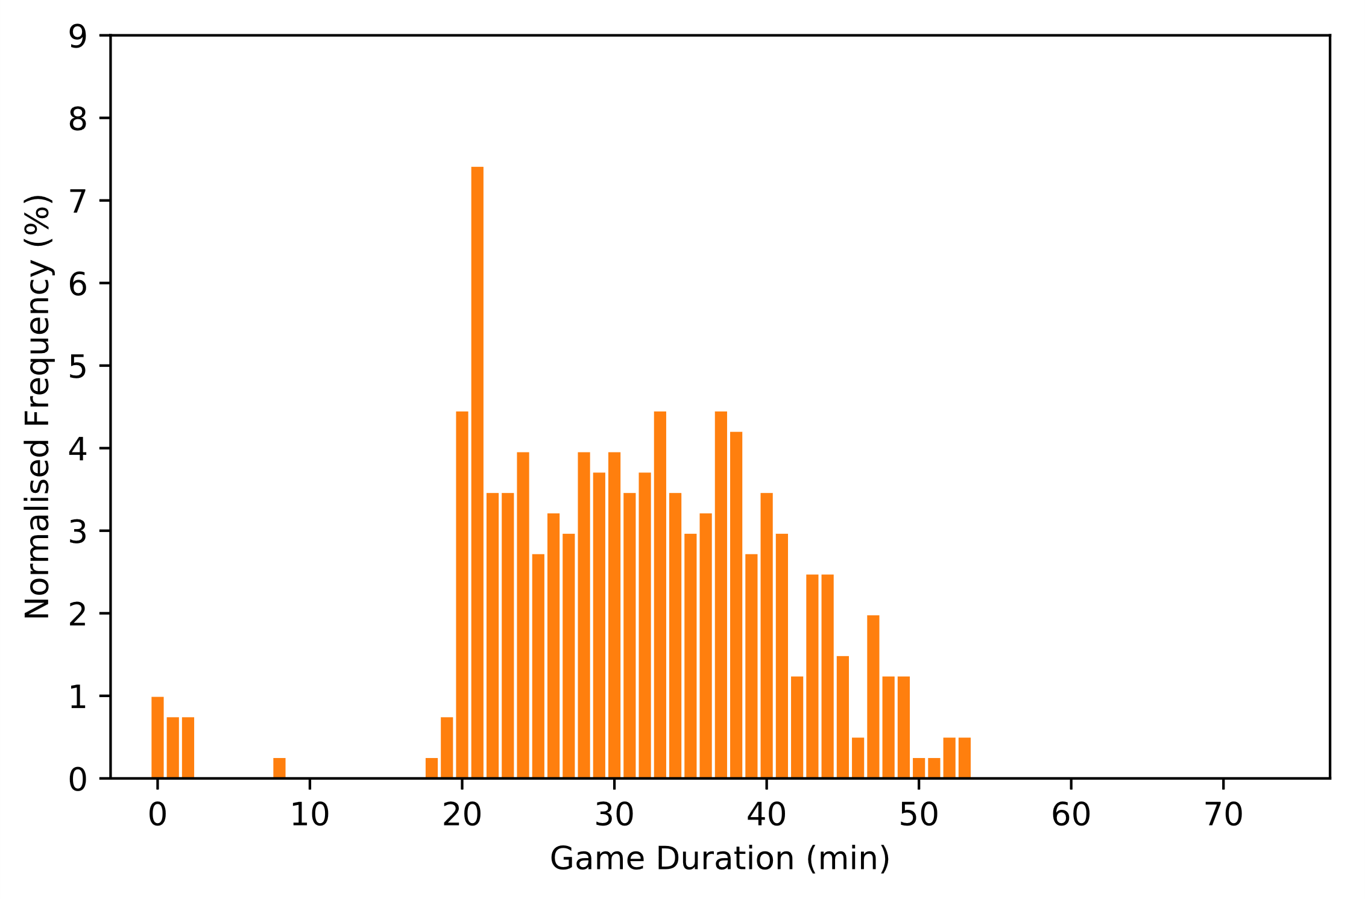
Unranked x Rich/English
N | max | med | mean | s
6,701 | 67 | 33 | 32.5659 | 9.1348
Unranked x Poor/Non-English
N | max | med | mean | s
405 | 53 | 31 | 31.2963 | 9.6499
Notes:
Plots

Slide 16
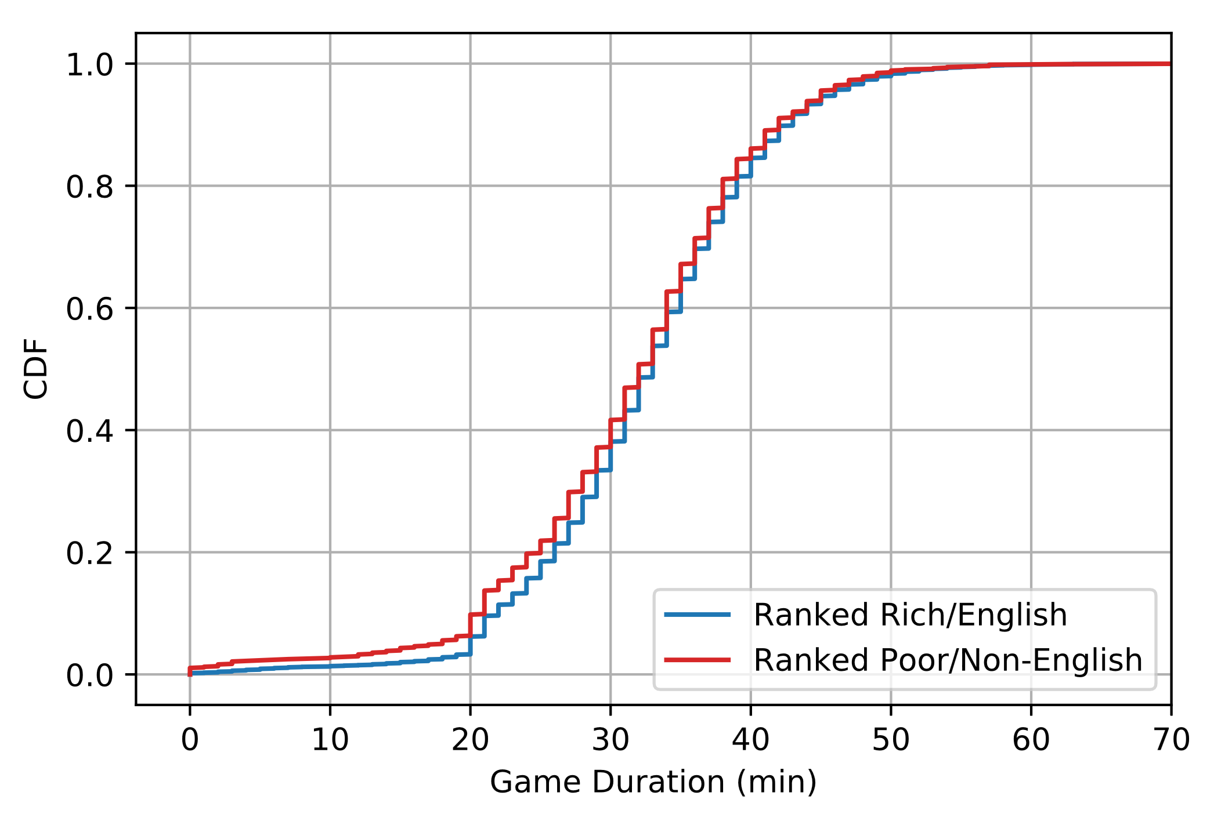
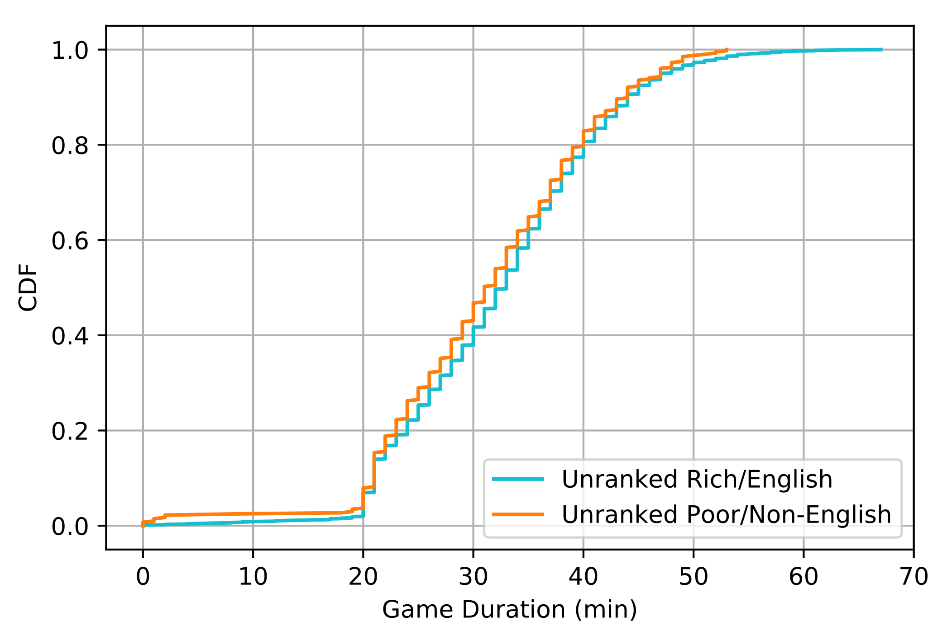
Comparing Regions / Game Type Held Constant
Two-Sample K-S test D = .0507 (4dp), p < .05
Two-Sample K-S test D = .0519 (4dp), p > .05

Slide 17
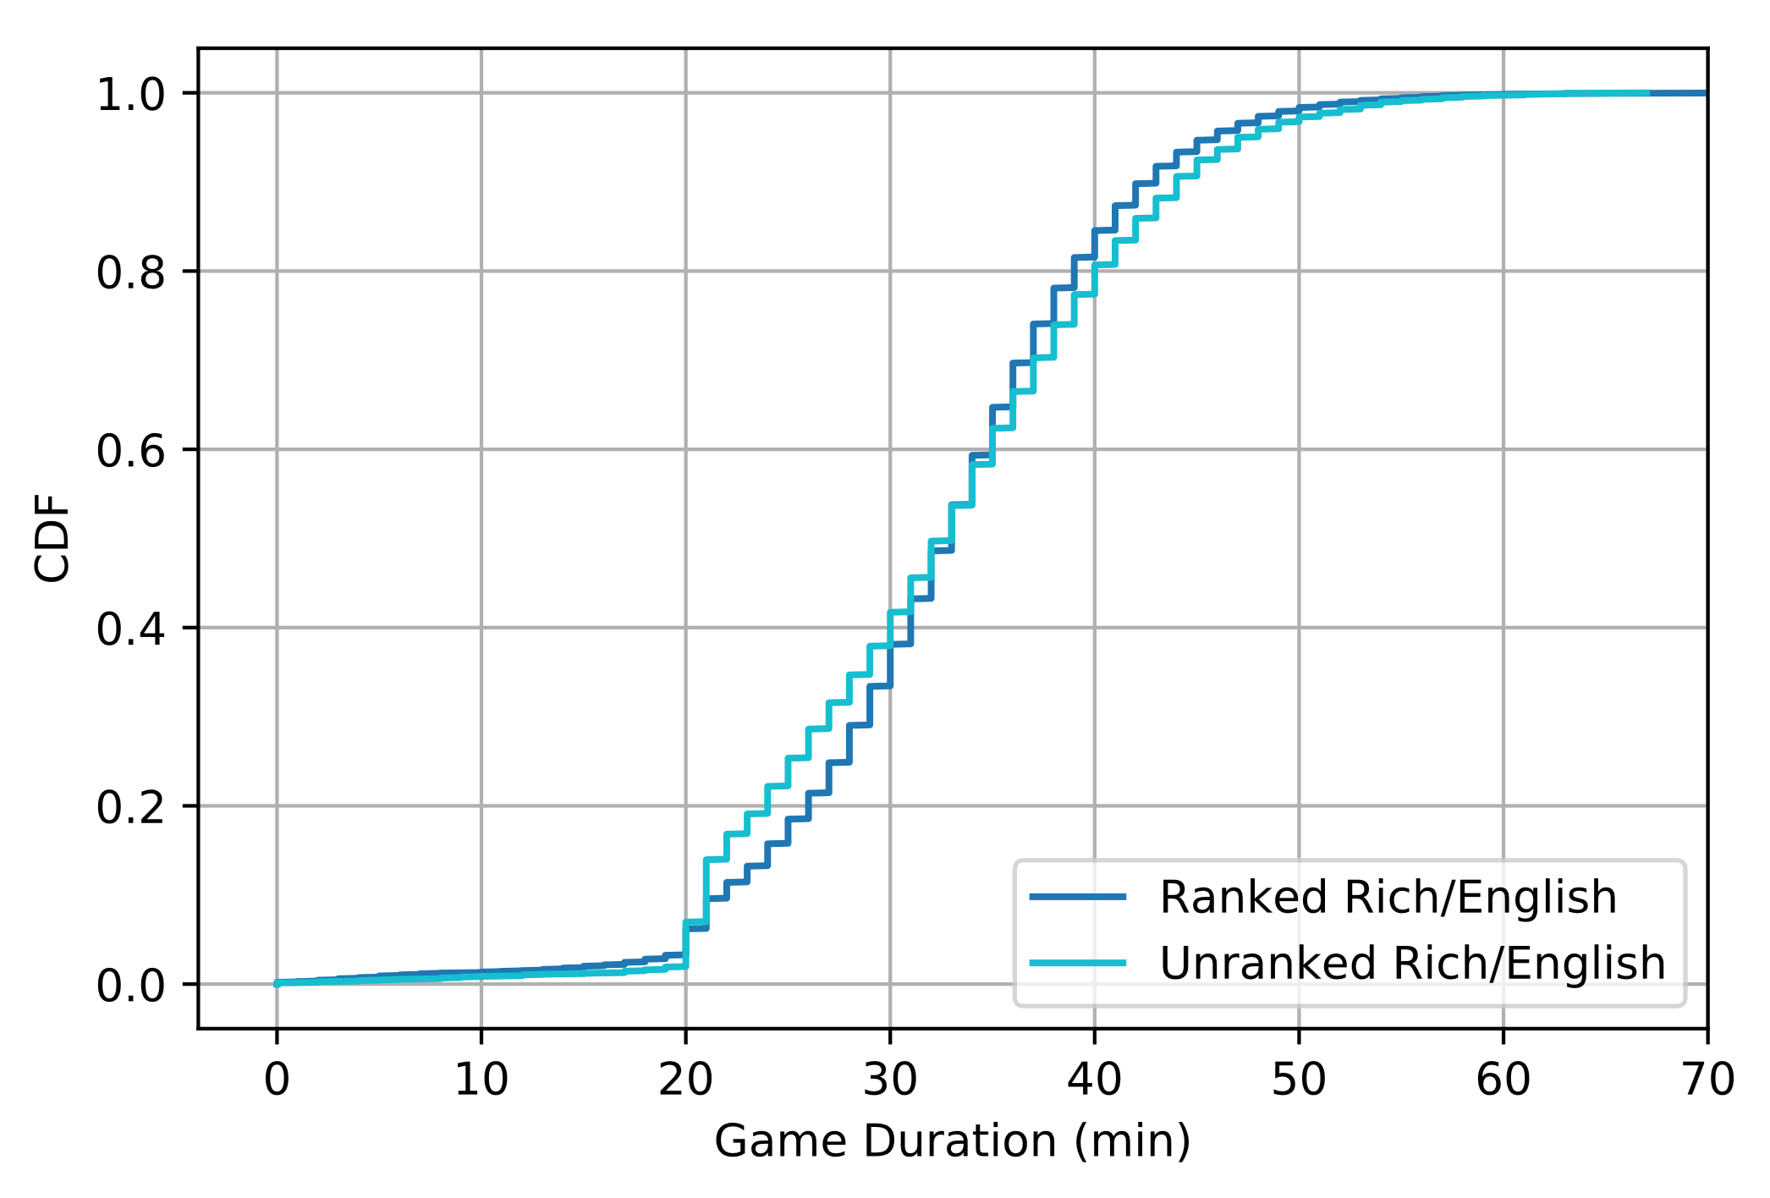
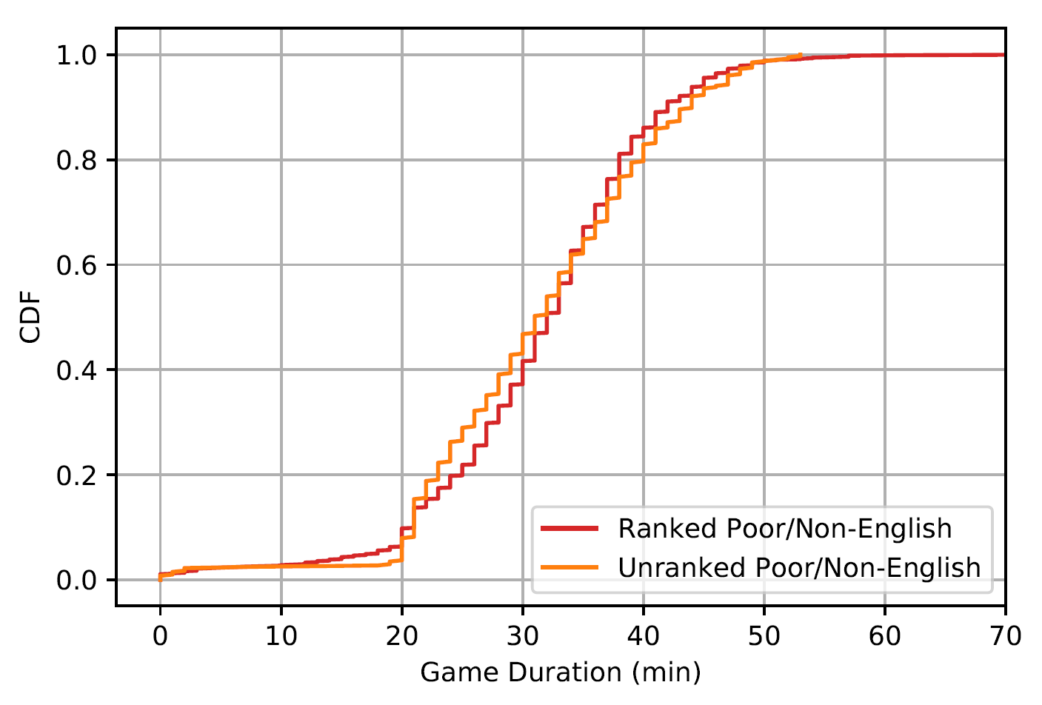
Comparing Game Type / Regions Held Constant
Two-Sample K-S test D = .0720 (4dp), p < .01
Two-Sample K-S test D = .0718 (4dp), p > .05
Notes:
Plots

Slide 18
Game Times
How is game start time affected by region (North America vs South America)? [rich/English vs poor/non-English]
Region:
Rich/English
North America
Poor/non-English
Brazil
Latin America North
Latin America South
Notes:
Examination of cultural differences
Difference in working hours(?)
How much time does a richer culture (NA) compared to a poor culture (SA)

Slide 19
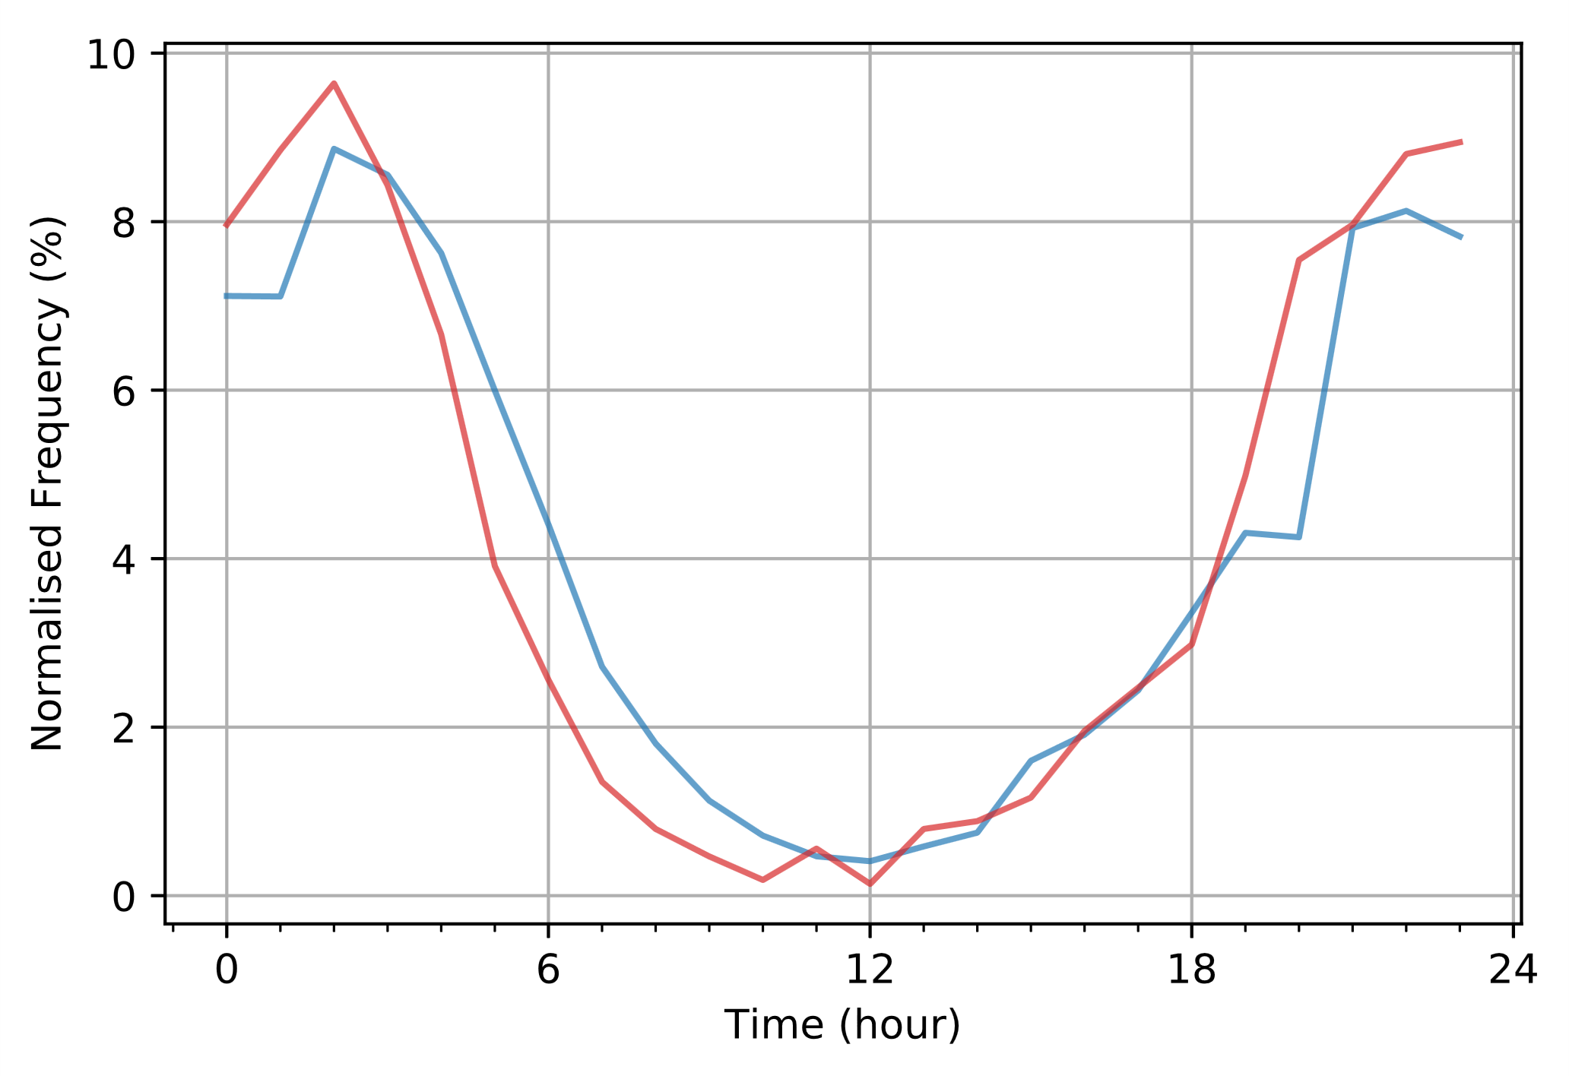
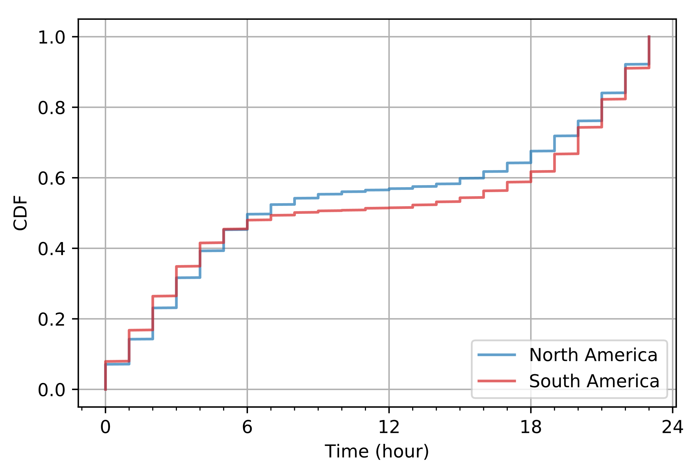
Game Times (24h day)
NA: N = 17,112 SA: N = 2,147
Two-Sample K-S test D = .0580 (4dp), p < .01
Notes:
Plots

Slide 20
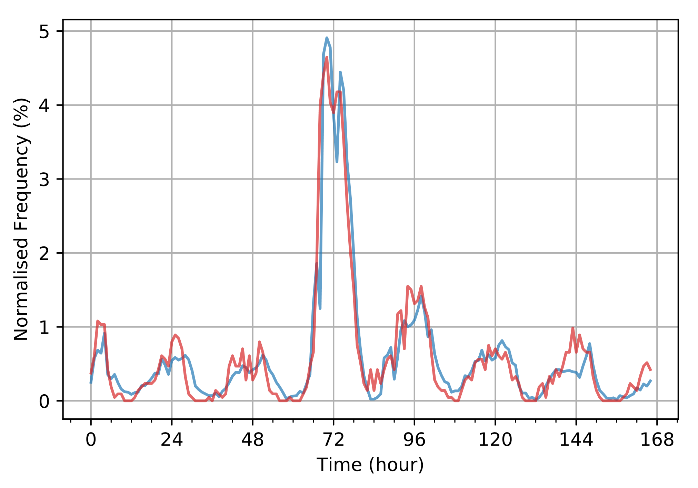
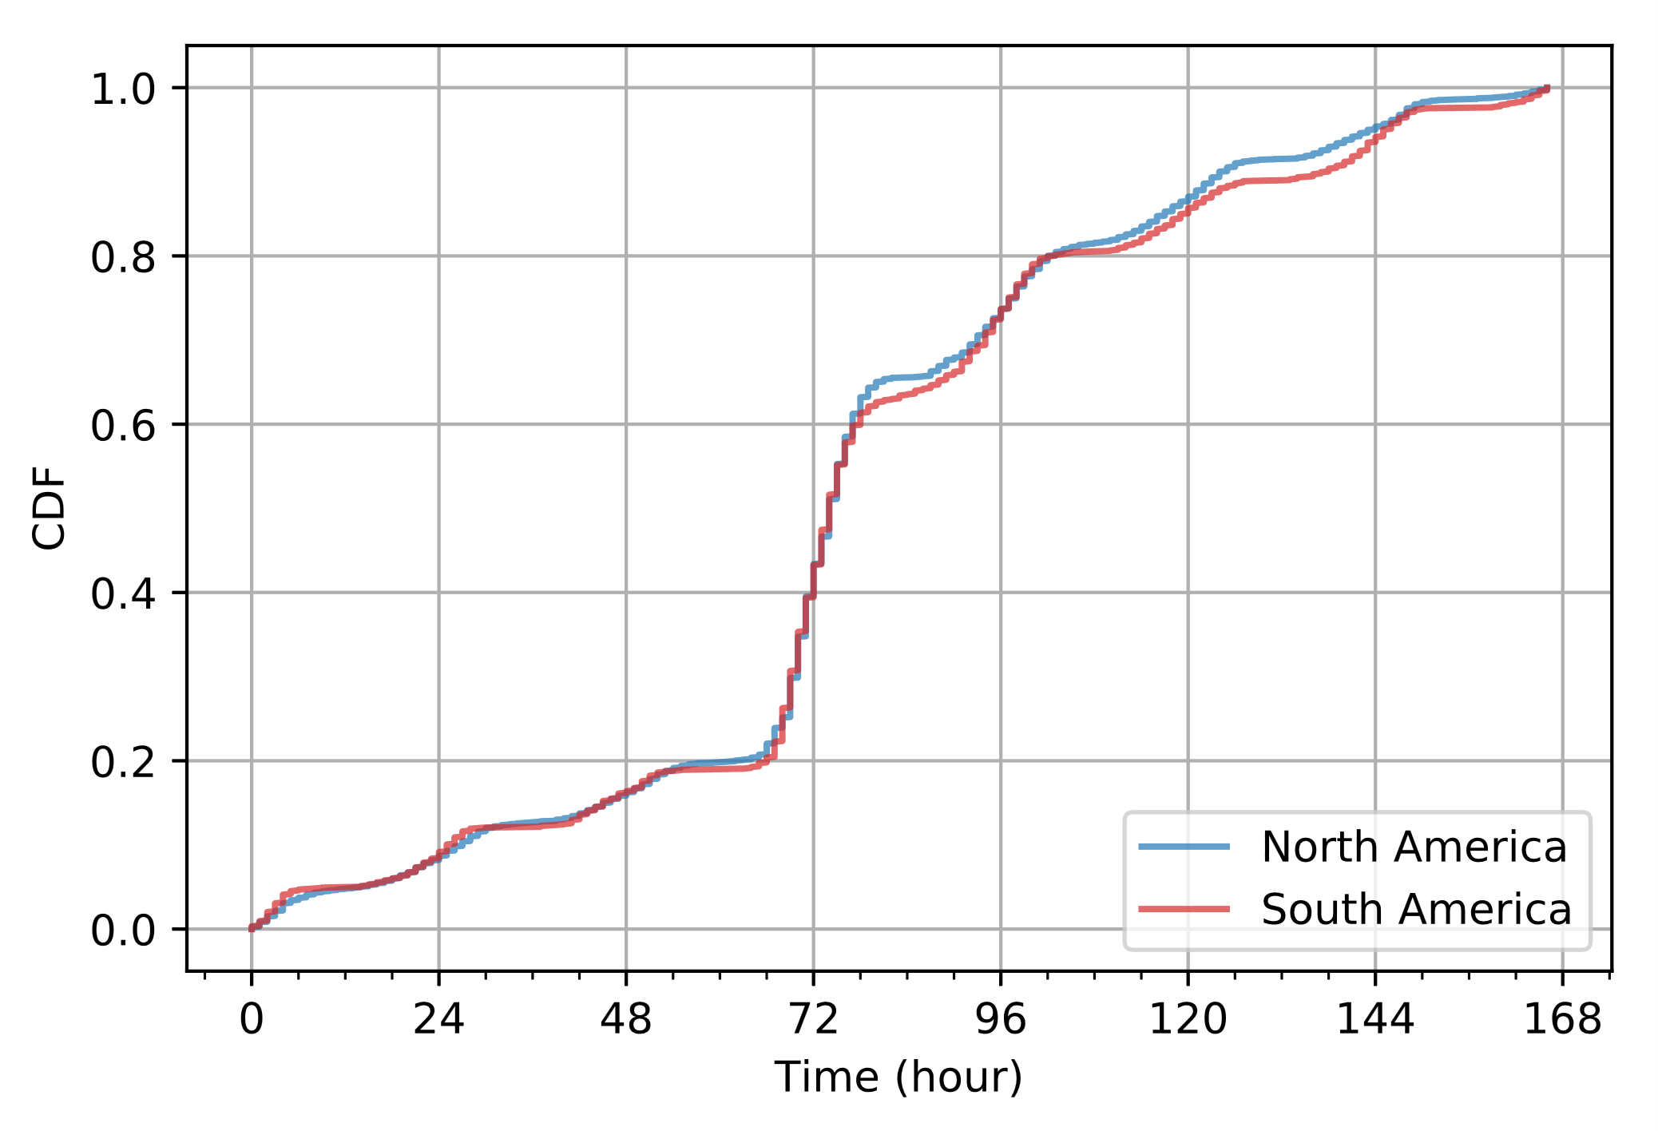
Game Times (168h week)
NA: N = 17,112 SA: N = 2,147
Two-Sample K-S test D = .0267 (4dp), p > .05

Slide 21
Ward Placement Over Time
Where are wards placed in unranked x rich/English games?
Rich/English
EU Northeast
EU West
North America
Oceania
Notes:
How do players in rank/unranked matches tend to place their wards during game, and when?
Do rank players tend to place their wards in similar areas of the map? Similar times?

Slide 22

Notes:
How do players in rank/unranked matches tend to place their wards during game, and when?
Do rank players tend to place their wards in similar areas of the map? Similar times?

Slide 23

Notes:
How do players in rank/unranked matches tend to place their wards during game, and when?
Do rank players tend to place their wards in similar areas of the map? Similar times?

